Slide 1
Magnetically Enhanced Microflow Cytometer for Bead-based Immunoaffinity Measurements in Blood Samples
Master Thesis Presentation
Johann A. Brenner
Munich, 30.03.2021

Slide 2
Outline
Theory
Immuno-Affinity Measurements in the Magnetic Flow Cytometer
Surface Chemistry Methods
Results
Simulation
Virtual Prototyping of Cell Signals
Calculus Estimation of the Force-Equilibrium in a Microchannel
Experimental
Magnetic Concentration Measurements
Development of a Differential Counting Setup
Established Reference Model for Surface Marker Expression Densities
Affinity-based Concentration Measurements in the Magnetic Flow Cytometer
Conclusion

Slide 3
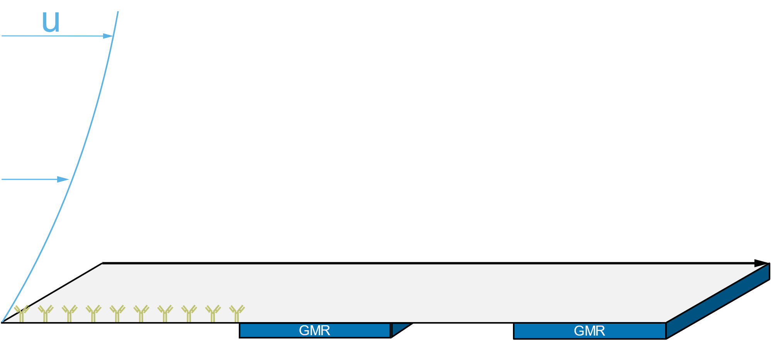

Slide 4
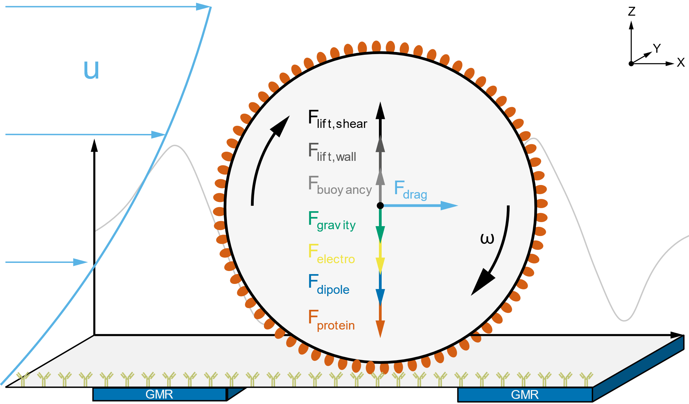
Theory
Immuno-Affinity Measurements in the Magnetic Flow Cytometer
Magnetic bead rolling on the floor of a microchannel
Biofunctionalized Channel
Force-Equilibrium:
Hydrodynamics
Volume Forces
Electro-Magnetism
➔ Change in Velocity or Adhesion

Slide 5
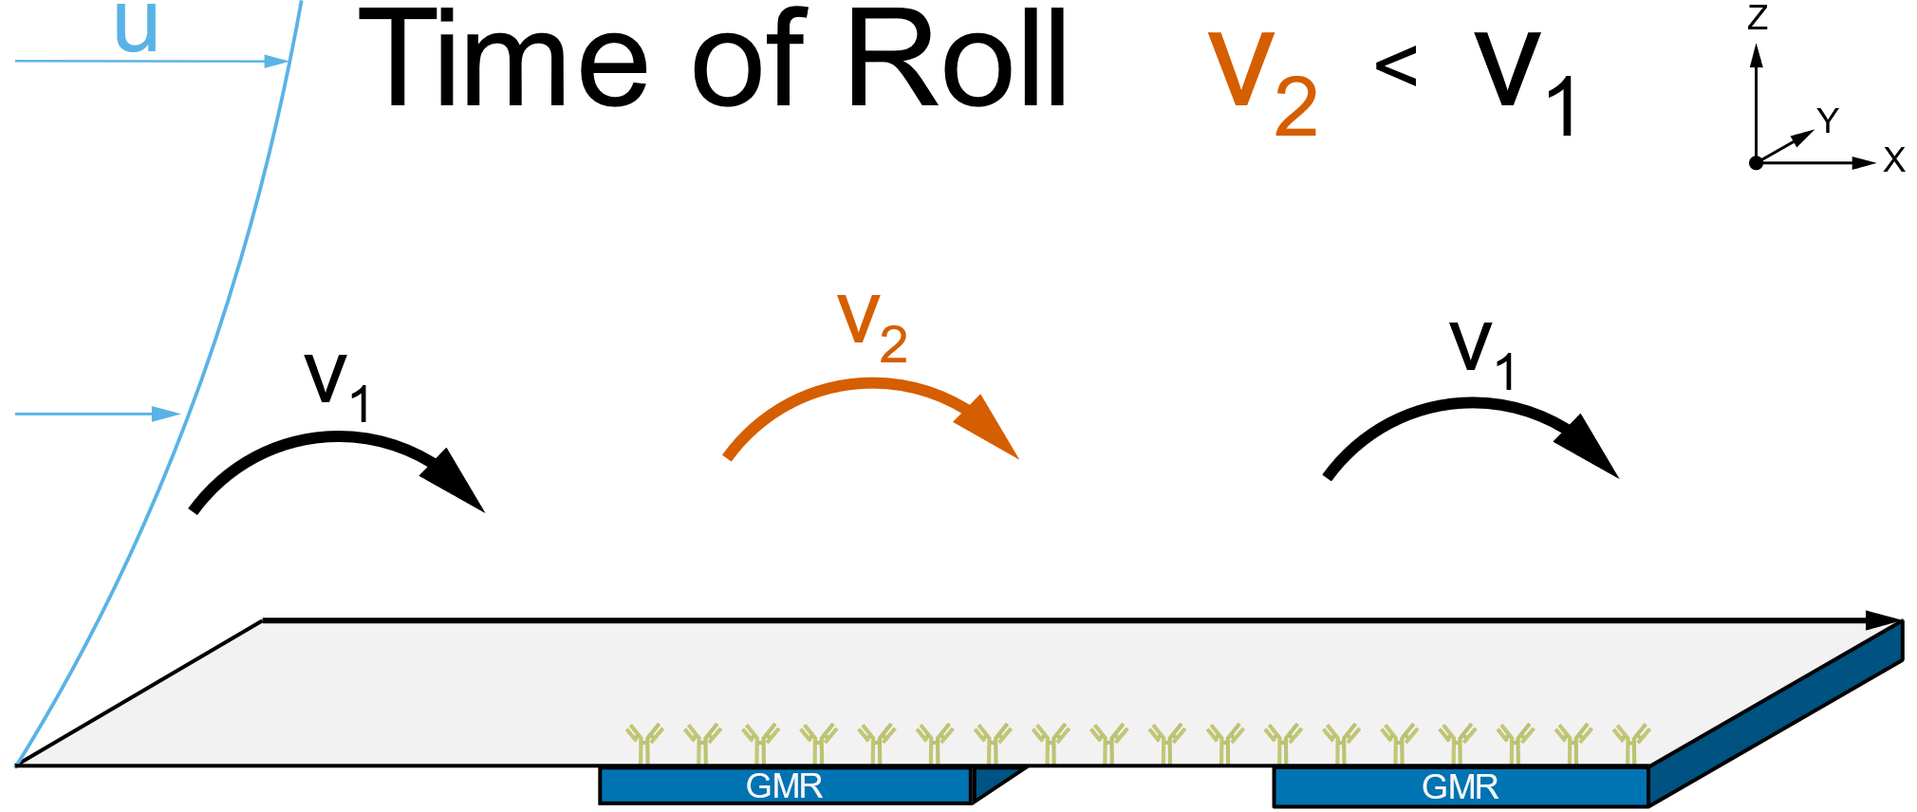
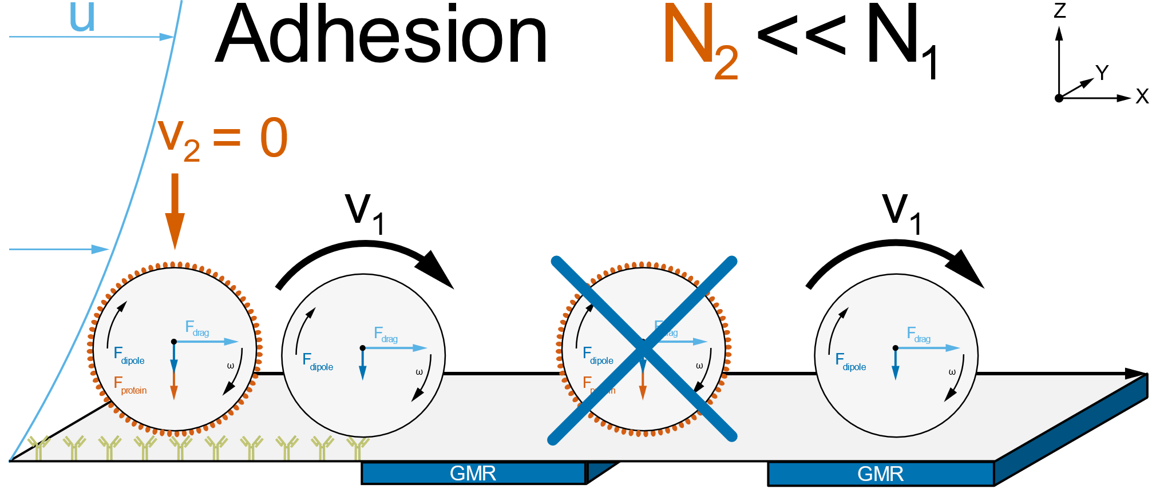
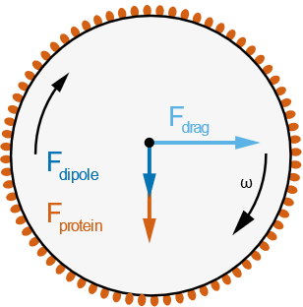
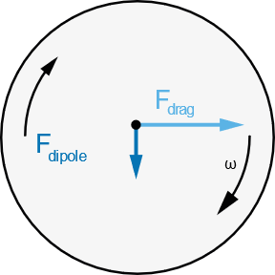
Theory
Immuno-Affinity Measurements in the Magnetic Flow Cytometer

Slide 6
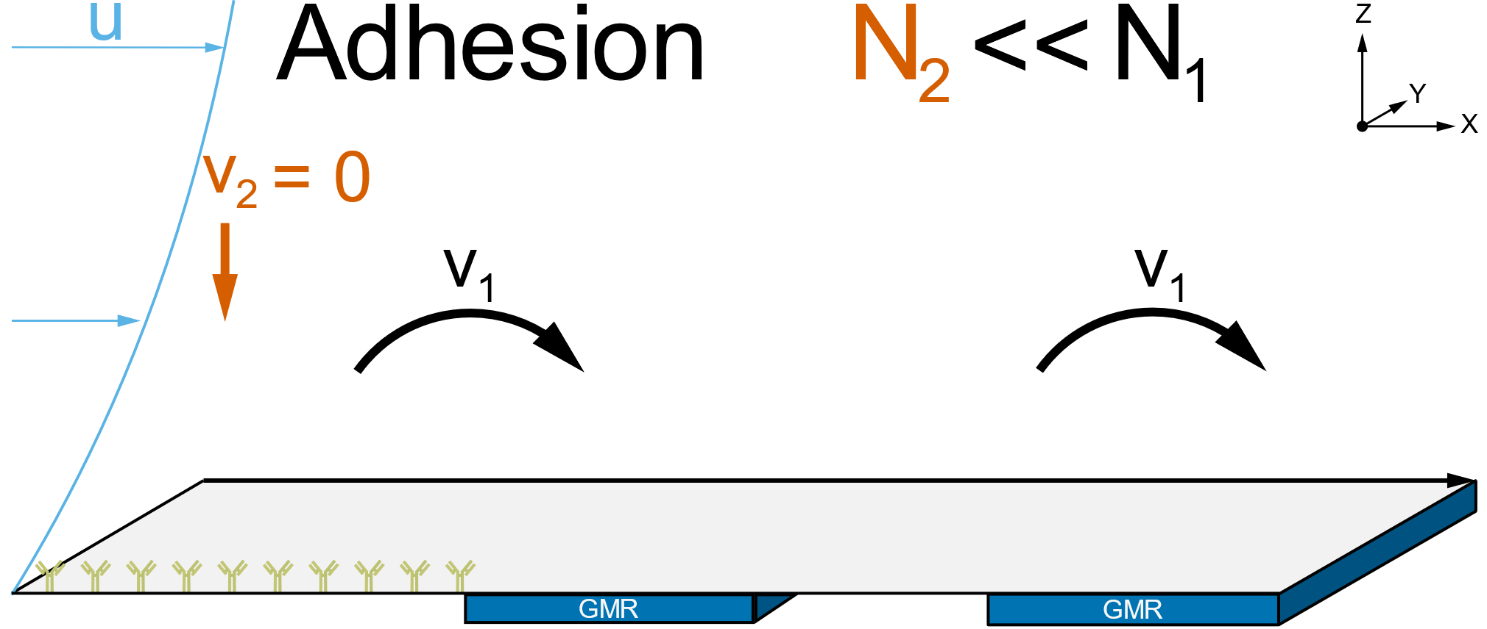
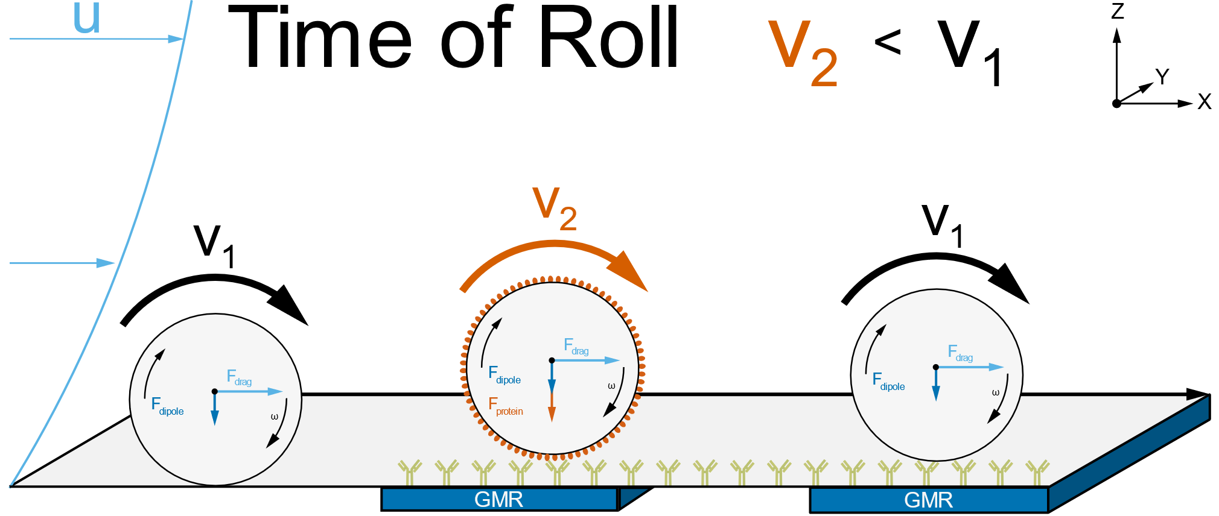
Theory
Immuno-Affinity Measurements in the Magnetic Flow Cytometer

Slide 7
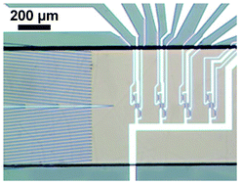
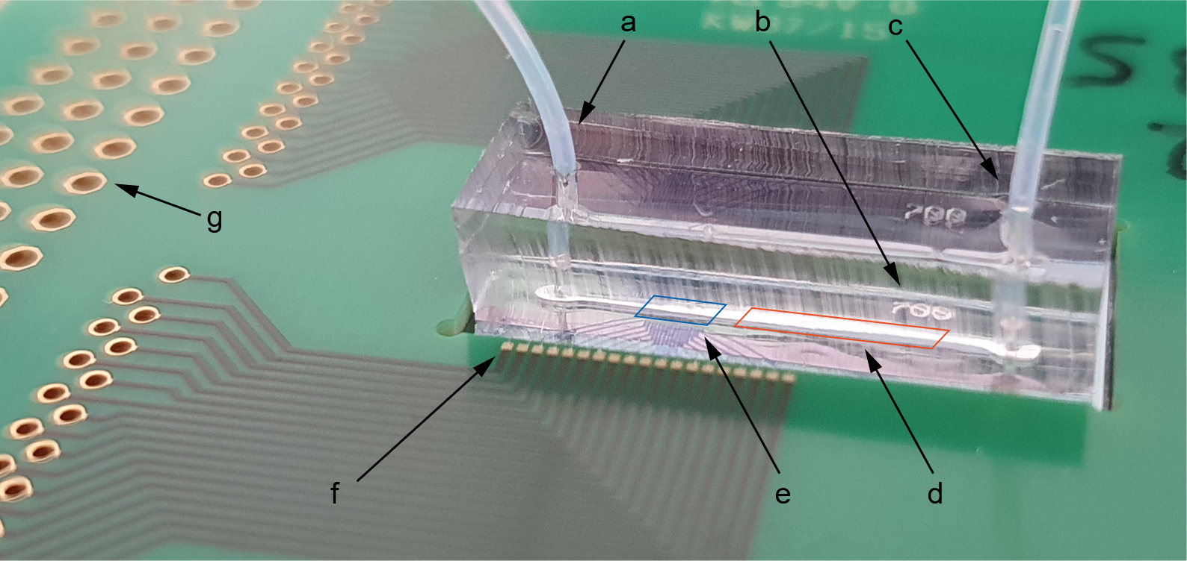
Theory
Immuno-Affinity Measurements in the Magnetic Flow Cytometer
2.5 mm
Helou et al. (2013) Lab on a Chip, 13(6)

Slide 8
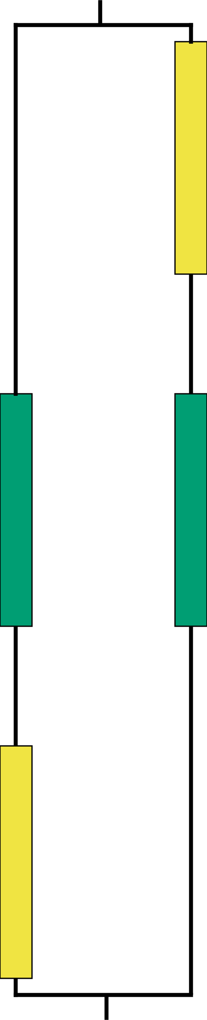
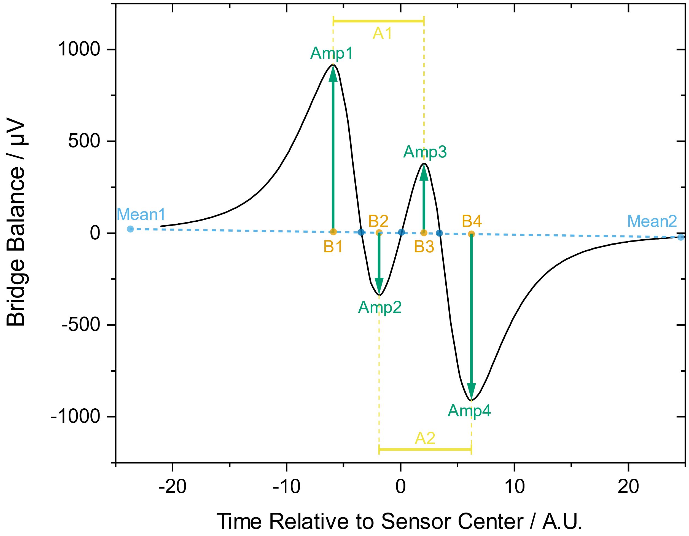
Theory
Immuno-Affinity Measurements in the Magnetic Flow Cytometer

Slide 9
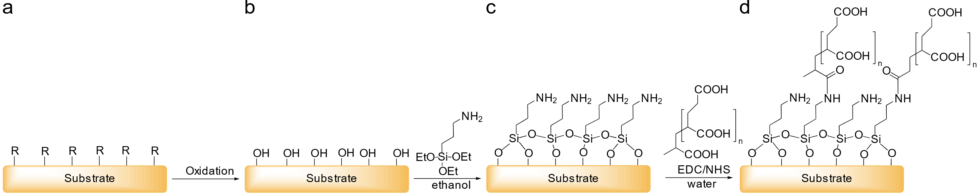
Theory
Surface Chemistry Methods – Covalent Modification
Oxidation
Silanization
Polymer Coating
Protein
Attachment

Slide 10
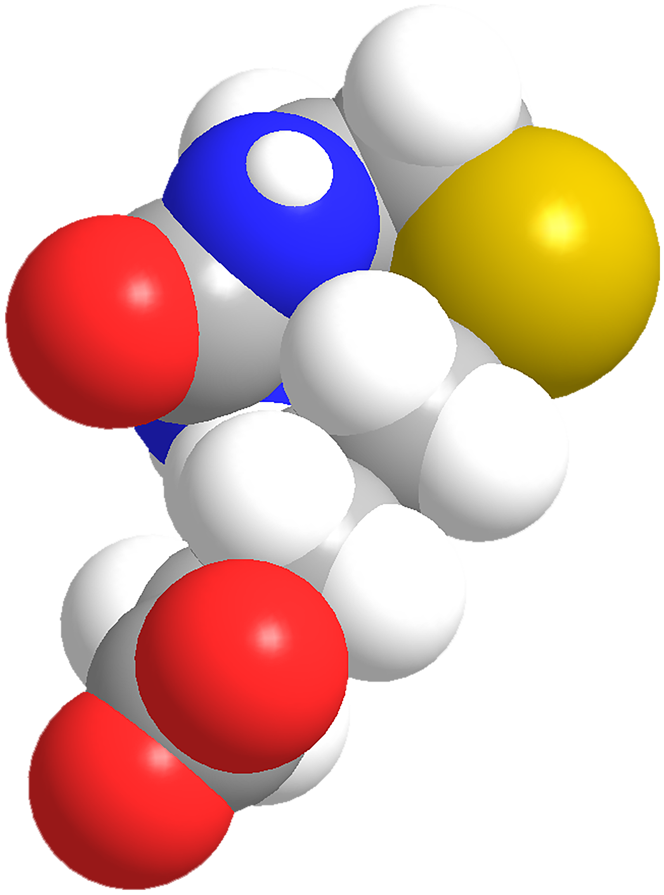
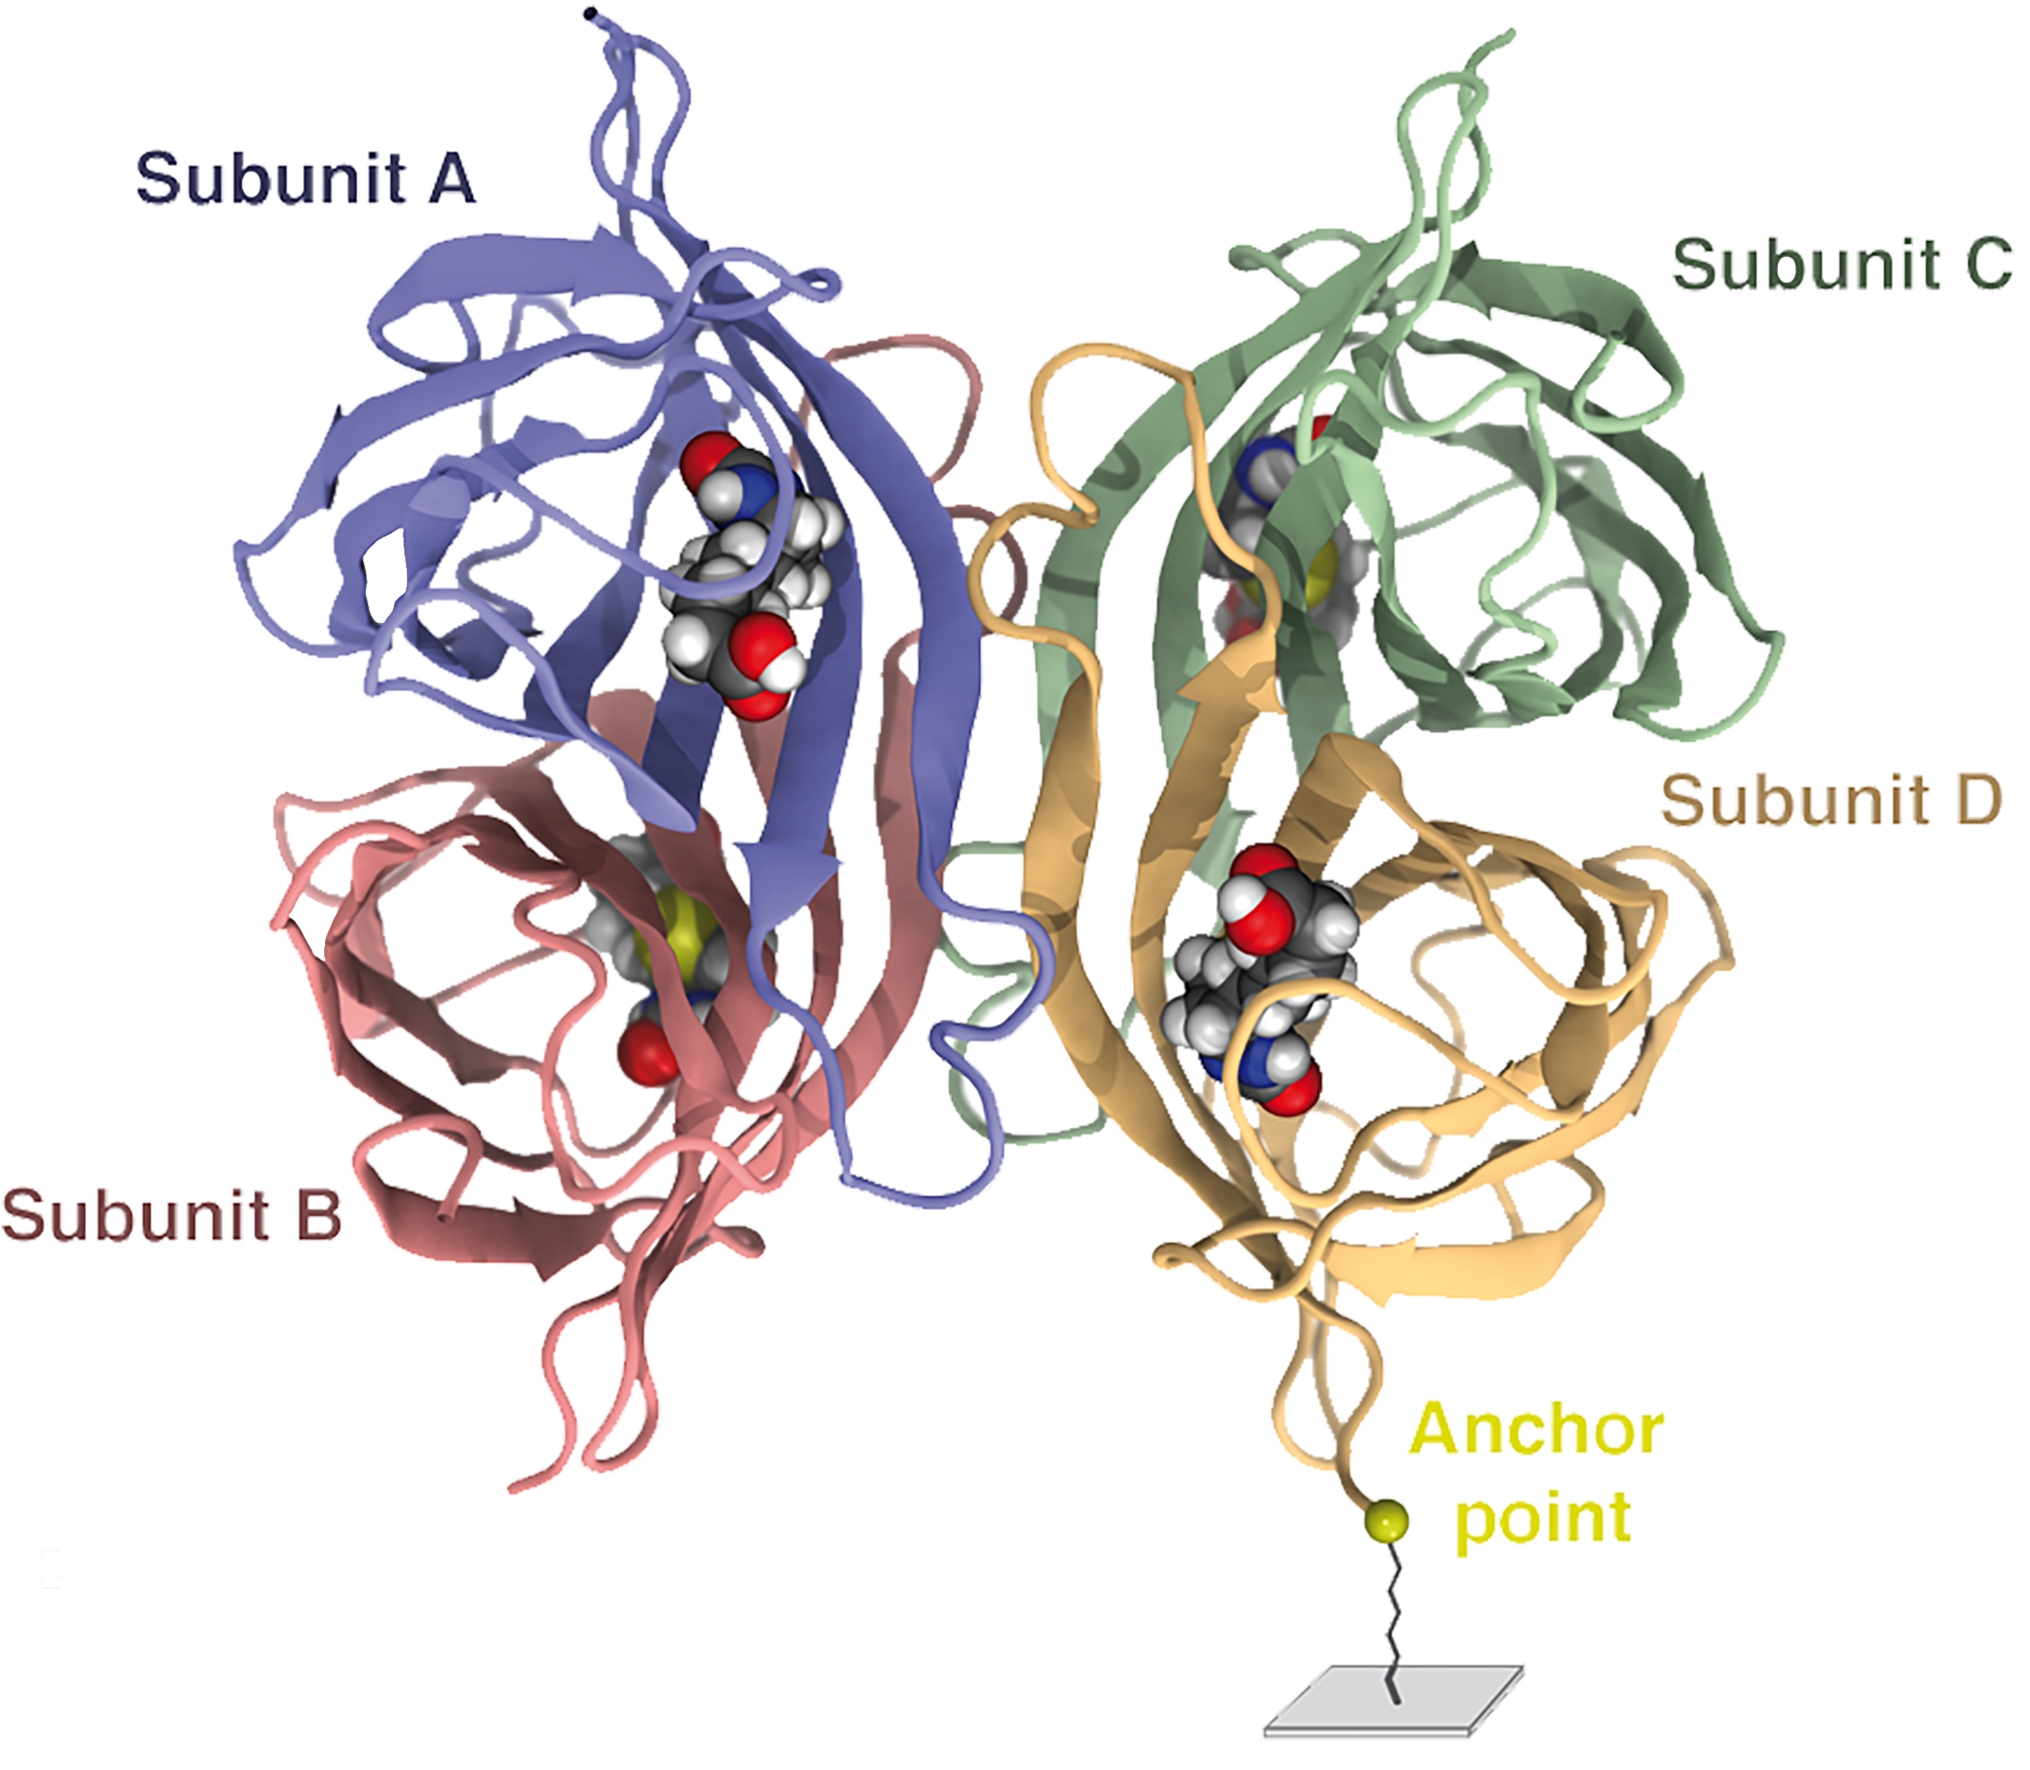
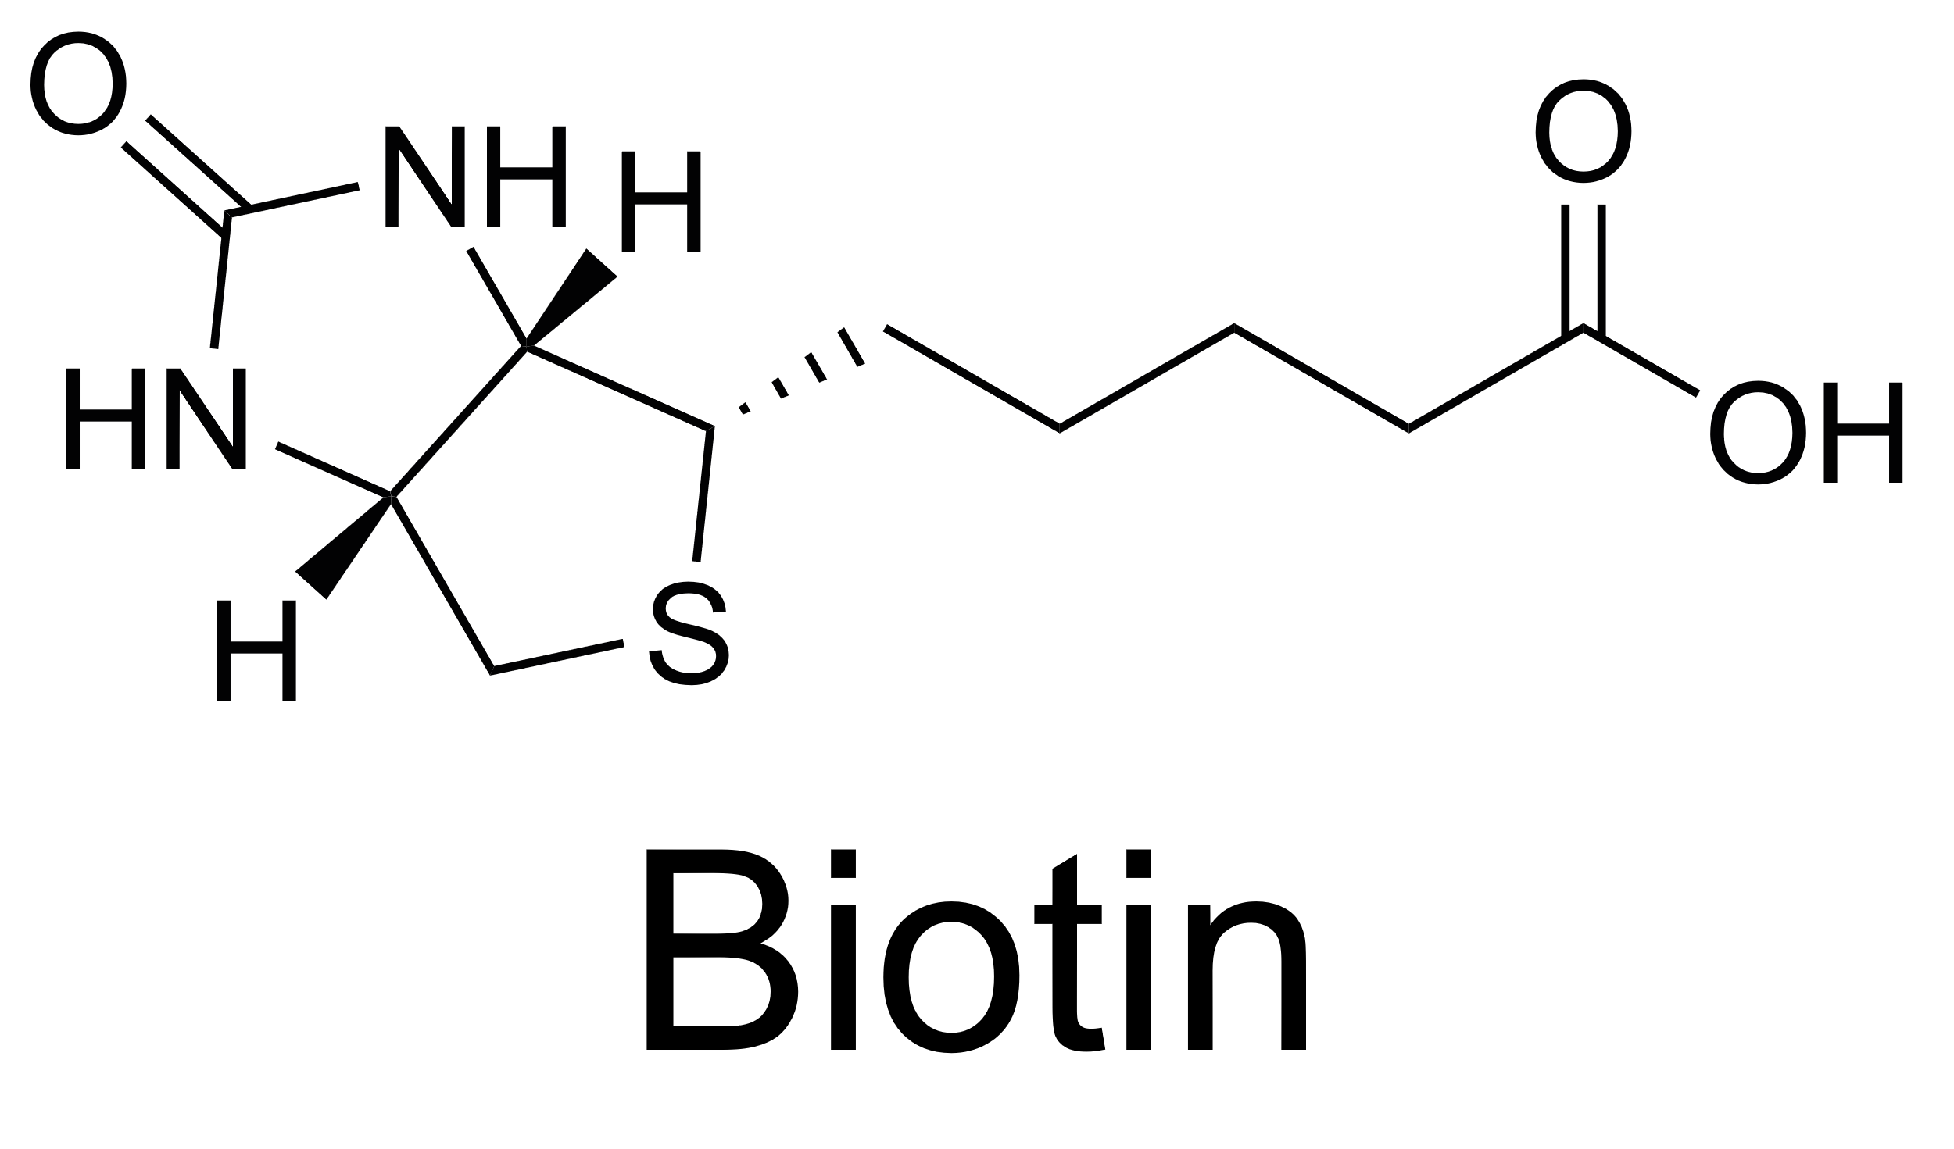
Theory
Surface Chemistry Methods – Biotin-Streptavidin
Biotin-Streptavidin Interaction
One of the strongest known non-covalent bonds
Affinity: 10⁻¹³ - 10⁻¹⁵
Release force: 100 – 400 pN
Adhesion
Sedlak et al. (2020) Sci Adv, 6(13)

Slide 11
Theory
Surface Chemistry Methods – Biotin-Streptavidin

Slide 12
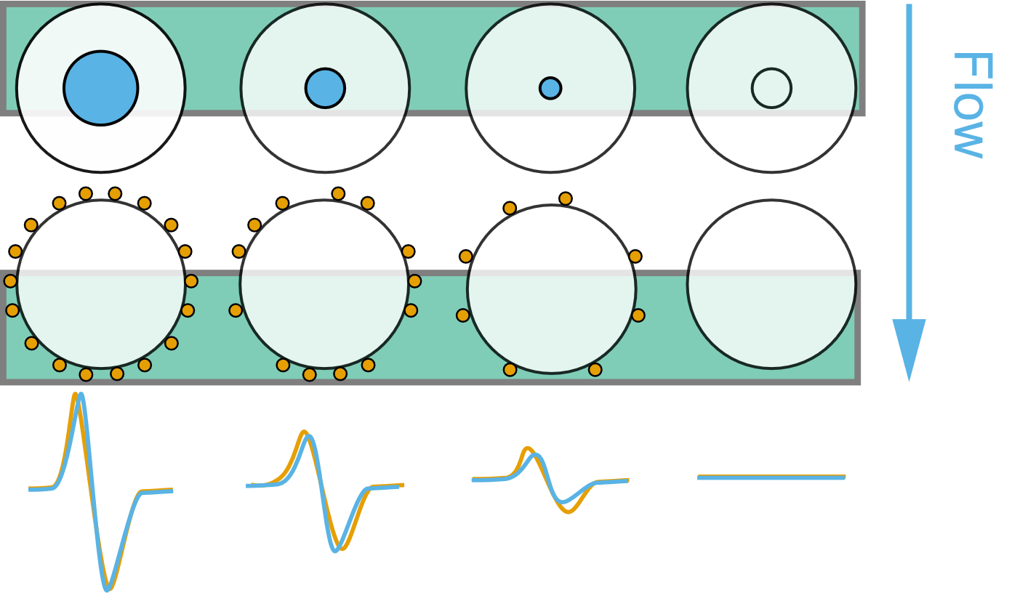
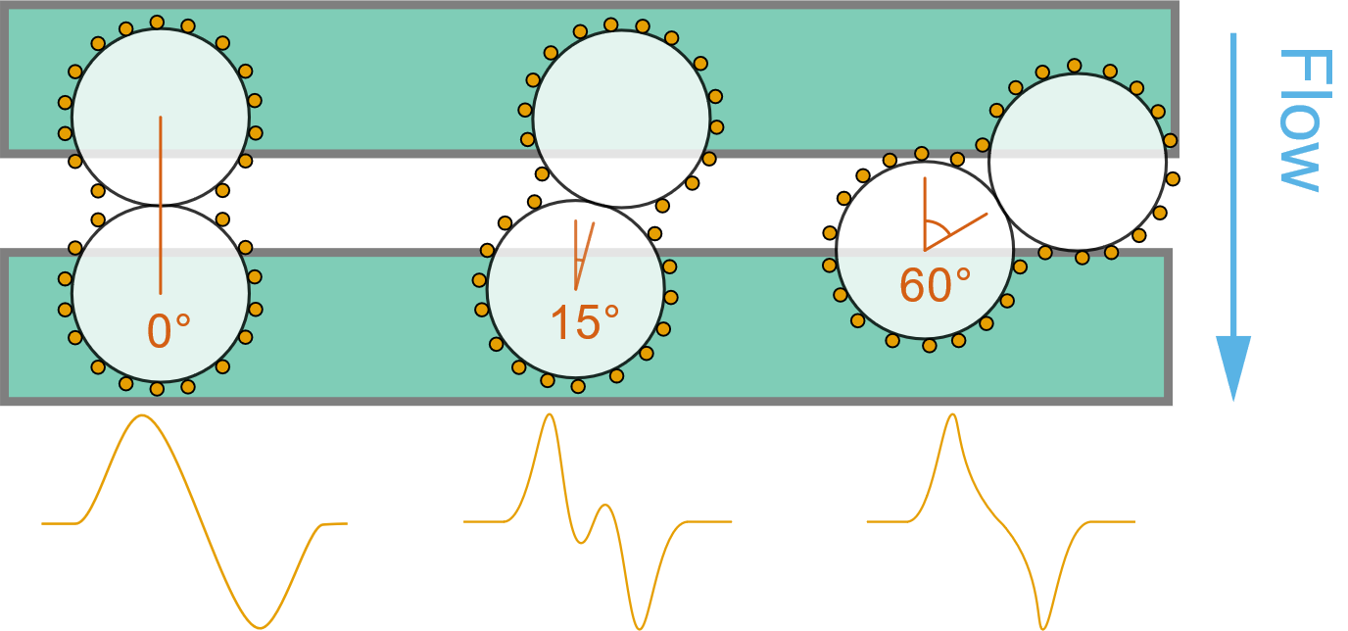
Results
Simulation – Virtual Prototyping of Cell Signals
MNP-Coverage Evaluation
Aggregate Angle Evaluation
Notes:
Simulation of cells which are labelled magnetically and flowing over the sensor bridge
Epitope density should be modelled
Left: Signal dependency of coverage
Compared to a reference dipole indicated by the blue circles → if all momentum is located in the center
Right: Influence of cell aggregates on the signal shape and their deviation from the reference dipole

Slide 13
Results
Simulation – Virtual Prototyping of Cell Signals
Low Coverage:
Single Magnetic Momenta cause field inhomogenity
Signal deterioration for larger cell diameters
Notes:
641 600 MNP with 20 nm
81 MNP with 2 μm
Left:
Low Coverage:
Single Magnetic Momenta cause field inhomogenity
magnetic momentum per MNP as it is dependent on the volume - thus r3.
Larger Particles cause more likely inhomogeneities
Right:
Maximum correlation shows also a significant deterioration for larger cell diameter
It is assumed, that the correlation error becomes constant at great Particles

Slide 14
Results
Simulation – Virtual Prototyping of Cell Signals

Slide 15
Results
Simulation – Virtual Prototyping of Cell Signals
High correlation in the medium coverage regime due to inhomgeneous field
Low yaw and high coverage → Two dipoles in superposition
High yaw and coverage → Aggregate cannot be discriminated by the sensor
Notes:
two 200 nm MNP-covered cells
Interestingly the error for 15° and 30° is largest
Low coverage: Field inhomogeneous, but not influenced by two spheres
For low yaw angle and high coverages
the aggregate’s signal reflects rather two single dipoles in superposition than one quite homogeneous dipole.
High yaw angle, and high coverages:
Two beads parallel to the large sensor side cannot be discriminated → similar correlation

Slide 16
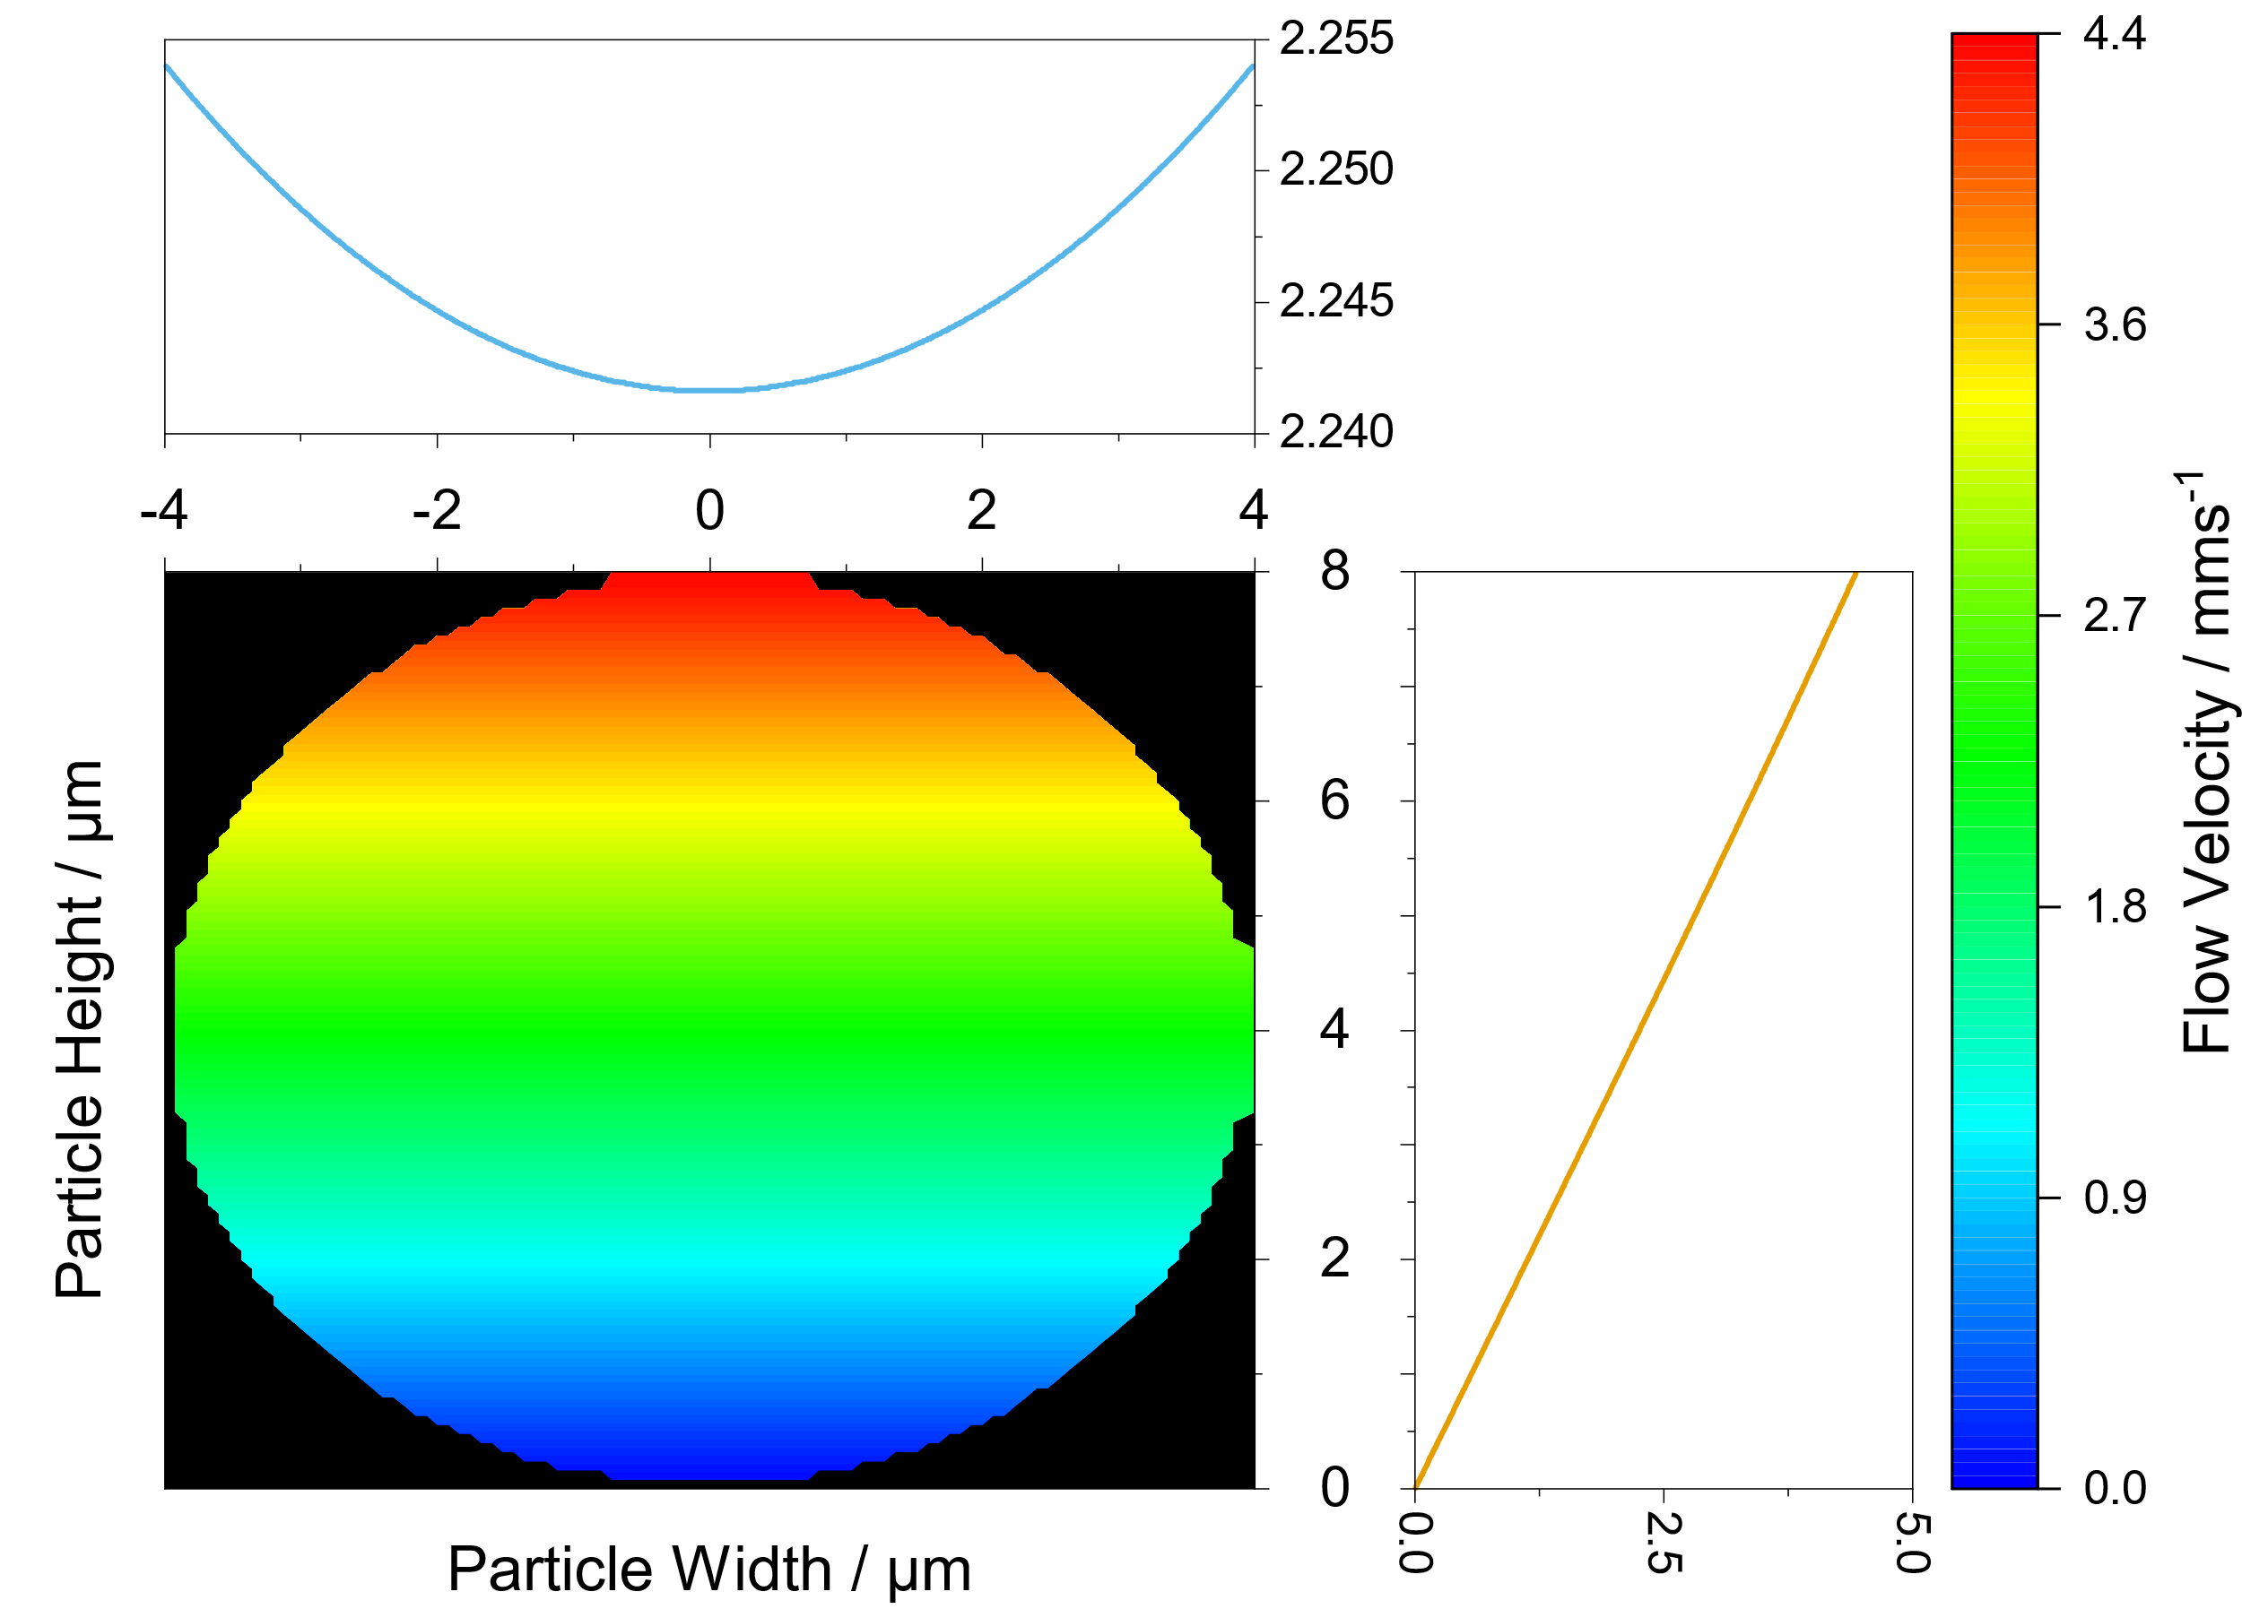
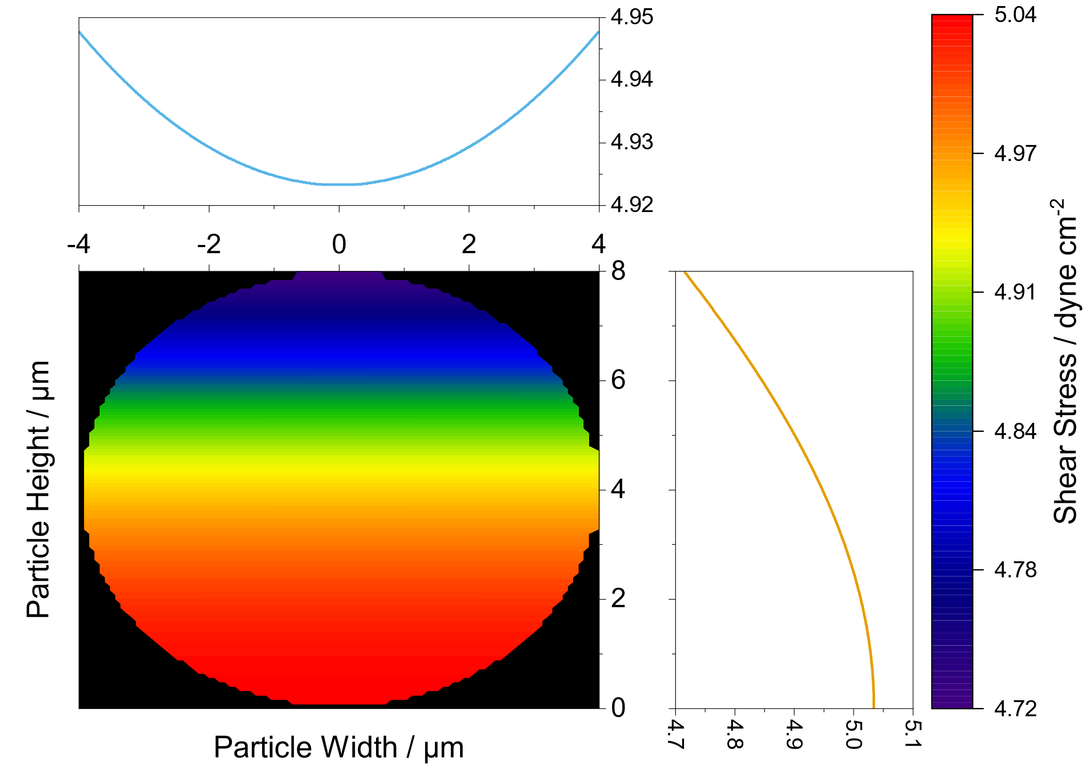
Results
Simulation – Calculus Estimation of the Force-Equilibrium in a Microchannel
Flow Field in a Particle
Shear Field in a Particle
Notes:
Framework has been developed to analyze the force equilibrium inside the channel and on the rolling bead
Flow induces rolling motion → Top is actuated more
However, high shear acts at the wall and thus the potential biological bonds.

Slide 17
Results
Simulation – Calculus Estimation of the Force-Equilibrium in a Microchannel
z
biotin
neutravidin
bead
Adopted from Wu and Voldman (2020) Biosensors and Bioelectronics, 154, 112070.
Notes:
By the analytical modelling of many forces, the dominant actors were identified
Stoke’s Drag Force, Magnetophoretic Force and Protein Interaction
fluid forces 500 pN in the flow direction (463.5 for 80µlmin)
Perpendicular
Magnetophoretic Structures:
for a 8 micron bead: 5 nN (5 kT/m) in the nickel-iron structures
Protein interaction:
8 micrometer bead with 1 µmol/g surface charges
177500 per bead
Bead approach: 30 nm

Slide 18
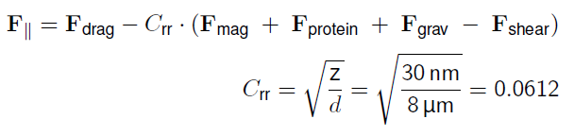
Results
Simulation – Calculus Estimation of the Force-Equilibrium in a Microchannel
z
biotin
neutravidin
bead
Adopted from Wu and Voldman (2020) Biosensors and Bioelectronics, 154, 112070.
Notes:
By the analytical modelling of many forces, the dominant actors were identified
Stoke’s Drag Force, Magnetophoretic Force and Protein Interaction
fluid forces 500 pN in the flow direction (463.5 for 80µlmin)
Perpendicular
Magnetophoretic Structures:
for a 8 micron bead: 5 nN (5 kT/m) in the nickel-iron structures
Protein interaction:
8 micrometer bead with 1 µmol/g surface charges
177500 per bead
Bead approach: 30 nm → Interaction area of 1.5 µm^2 or 0.75% of the particle
1300 proteins bond potentially
Different Protein relase forces lead to 5-200 nN adhesion
rolling resistance factor for a perfectly elastic surface from the car and bike industry
Project perpendicular forces in flow direction

Slide 19
Theory
Surface Chemistry Methods – Biotin-Streptavidin
Predominant Forces
Stoke‘s Drag: 460 pN
Dipolar Force: 5 nN
Protein Force: 5-200 nN
Unfunctionalized Bead
150 pN Drag
Bio-Functionalized Bead
Adhesion caused by 16 - 500 molecules of neutravidin
Notes:
Assuming an unfunctionalized bead this lead to 150 pN in flow
Interaction of 16 to 500 neutravidin molecules (respective release force)

Slide 20
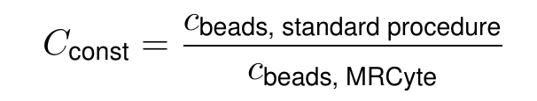
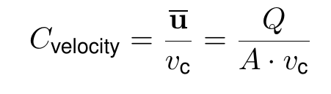
Results
Experimental – Magnetic Concentration Measurements
Bead stocks characterized in the flow cytometer precisely
Empirical correction factors to account for bead losses in interconnections and flow profile:
Notes:
Measure adhesion → Concentration Measurements neccessary
Measured counts lower than in sample → losses in syringe, tubing, flow profile
Correction factor:
With previously known concentration → Cconst → Normalized to a standard procedure
If velocity is determined robustly → Cvelocity → Fraction of the Particle velocity from the flow profile.

Slide 22
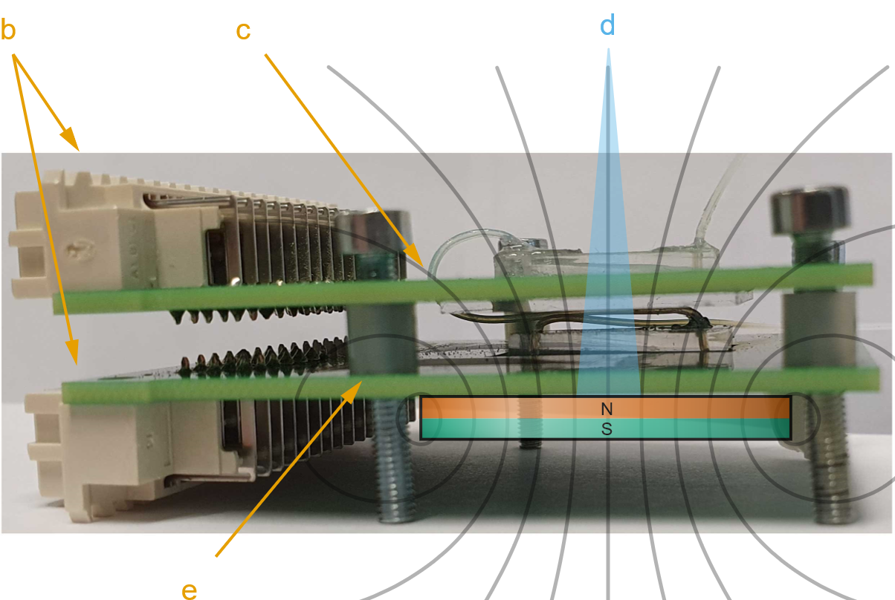
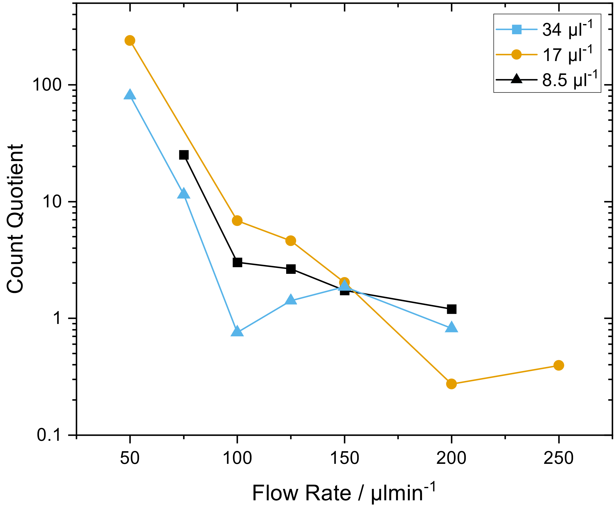
Results
Experimental – Development of a Differential Counting Setup
Notes:
To get rid of the absolute counting and the related errors, → relative/differential counting setup was built from existing components
In plane integration not possible → window of perpendicular field lines is too narrow
Non perpendicular components → Exactly measurement direction
Stacking of the two PCB-carriers with spacers in between
drilled hole in the top to interconnect

Slide 23
Results
Experimental – Development of a Differential Counting Setup
Notes:
To get rid of the absolute counting and the related errors, → relative/differential counting setup was built from existing components
In plane integration not possible → window of perpendicular field lines for the magnetophoresis is too narrow
Non perpendicular components → Exactly measurement direction
Stacking of the two PCB-carriers with spacers in between
drilled hole in the top to interconnect
However, sensitivities are not really promising, but sufficient for beads
Due to the height difference, the gradients are also different in magnitude → Magnetic field → r^3
What does that mean?
Low flow rate: Slow beads, perfectly pulled down on top and measured, Adhesion at the bottom → Force equilibrium dominated by magnetic force
High Flow rate: Beads to fast to get pulled down in the low gradient on top
Optimal Flow rate determined by the quotient → Optimum at 160 µl
Notwithstanding, magnitude of measured beads is too low → Omitting this idea

Slide 24
Results
Experimental – Development of a Differential Counting Setup

Slide 25
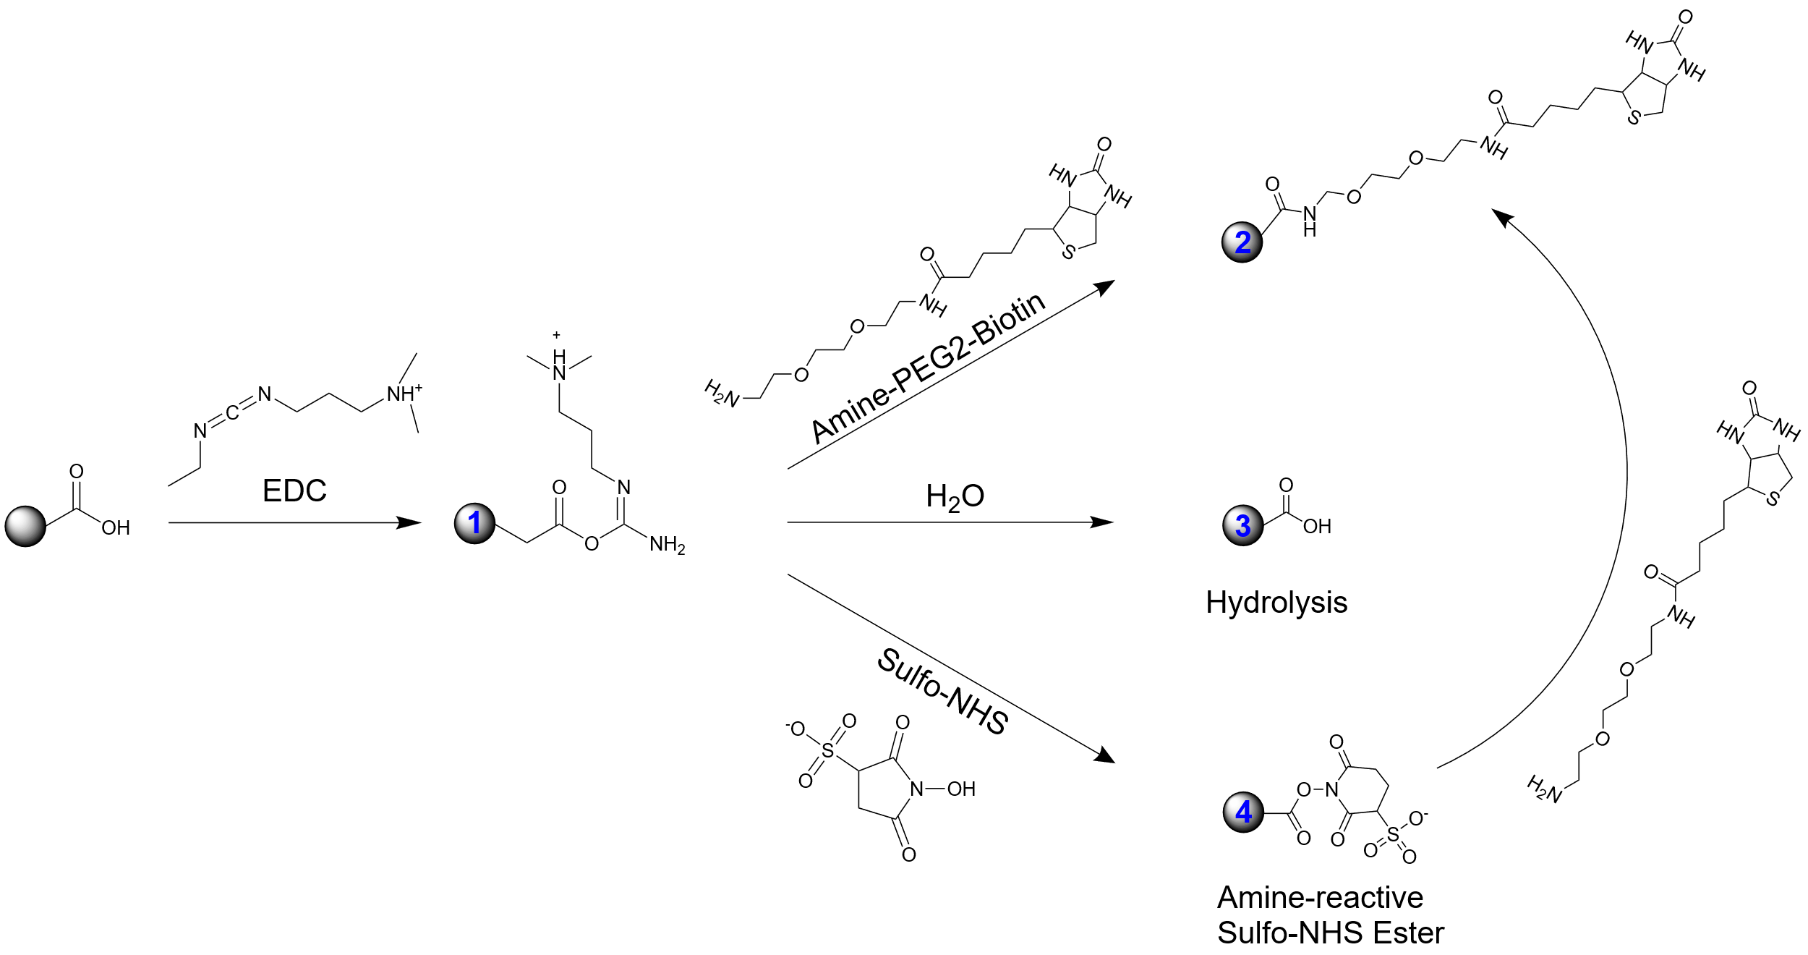
Results
Experimental – Established Reference Model for Surface Marker Expression Densities
Proof of concept for the simulations in the magnetic flow cytometer
Epitope Density on a cell has to be modulated
Development of a methodology to coat beads with highly defined surface markers
Universally applicable to proteins
→ Carbodiimide Chemistry

Slide 26
Notes:
Carboxy left, Amine in center, Antibody on carboxylate right

Slide 27
Notes:
Half life of carboxylate beads → 1.4 days → Can probably be attributed to improper washing
→ Saw bead disintegration → Something happens

Slide 28
Results
Experimental – Established Reference Model for Surface Marker Expression Densities
Concenctration measurement of magnetized polystyrene beads
Notes:
Non-magnetic polystyrene beads functionalized by previous protocol
Magnetized with 50nm MNPs
Weakly, but significant difference between functionalization densities visible
Decrease in relative counts with less mnp coverage
Get not pulled to bottom
Velocity Distribution of Fully and partly coated beads shows equal mean
→ no difference in rolling attributed to more magnetic force measurable

Slide 29
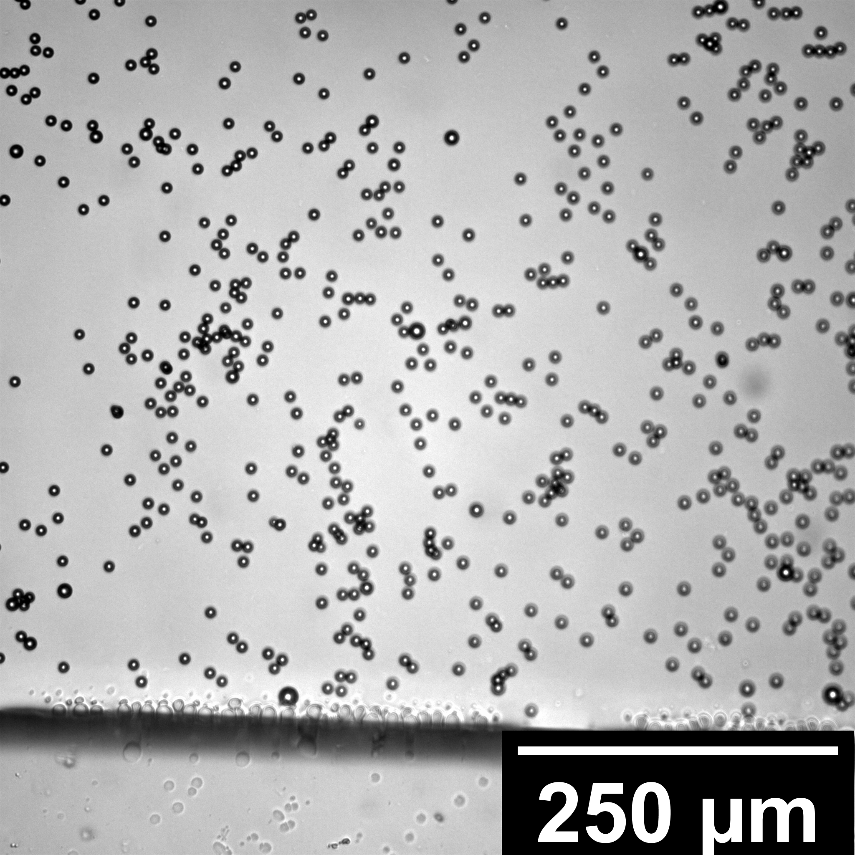
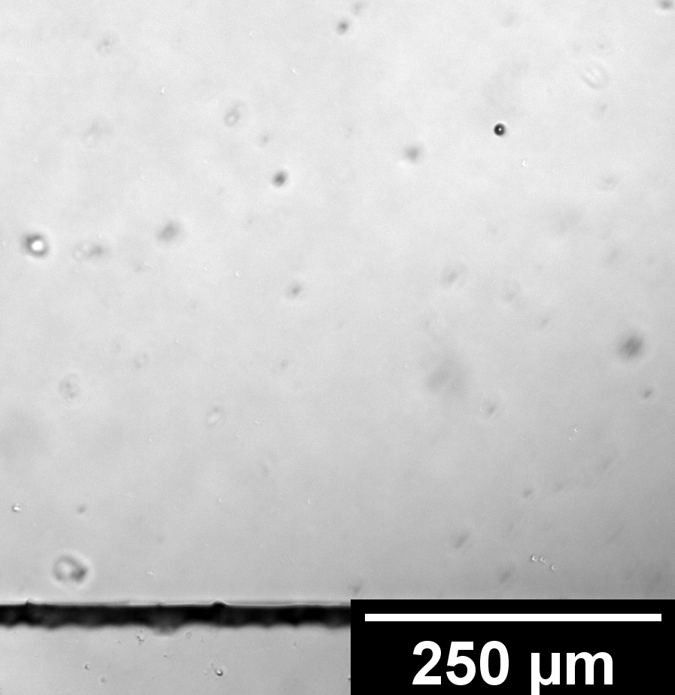
Results
Experimental – Affinity-based Concentration Measurements in the Magnetic Flow Cytometer
Biotinylated Beads
Plain Beads
Notes:
These biotinylated beads were pumped over a covalently functionalized surface
Microscope images showed promising results
PDMS works best
SiN works worst
Worse Glass attributed to all measurements in the beginning of the thesis
Not sure if covalent or not → No adequate method in reach

Slide 30
Results
Experimental – Affinity-based Concentration Measurements in the
Magnetic Flow Cytometer
Notes:
Titration of surface functionalization:
Neutravidin Titrated :
Again Bead Density evaluation
Fluorescence Microscopy Evaluation → Channel imaged and referenced to a blank
However:
covalent modification is time and ressource consuming
Unspecific Physisorption is not much worse → Will be used in further work

Slide 31
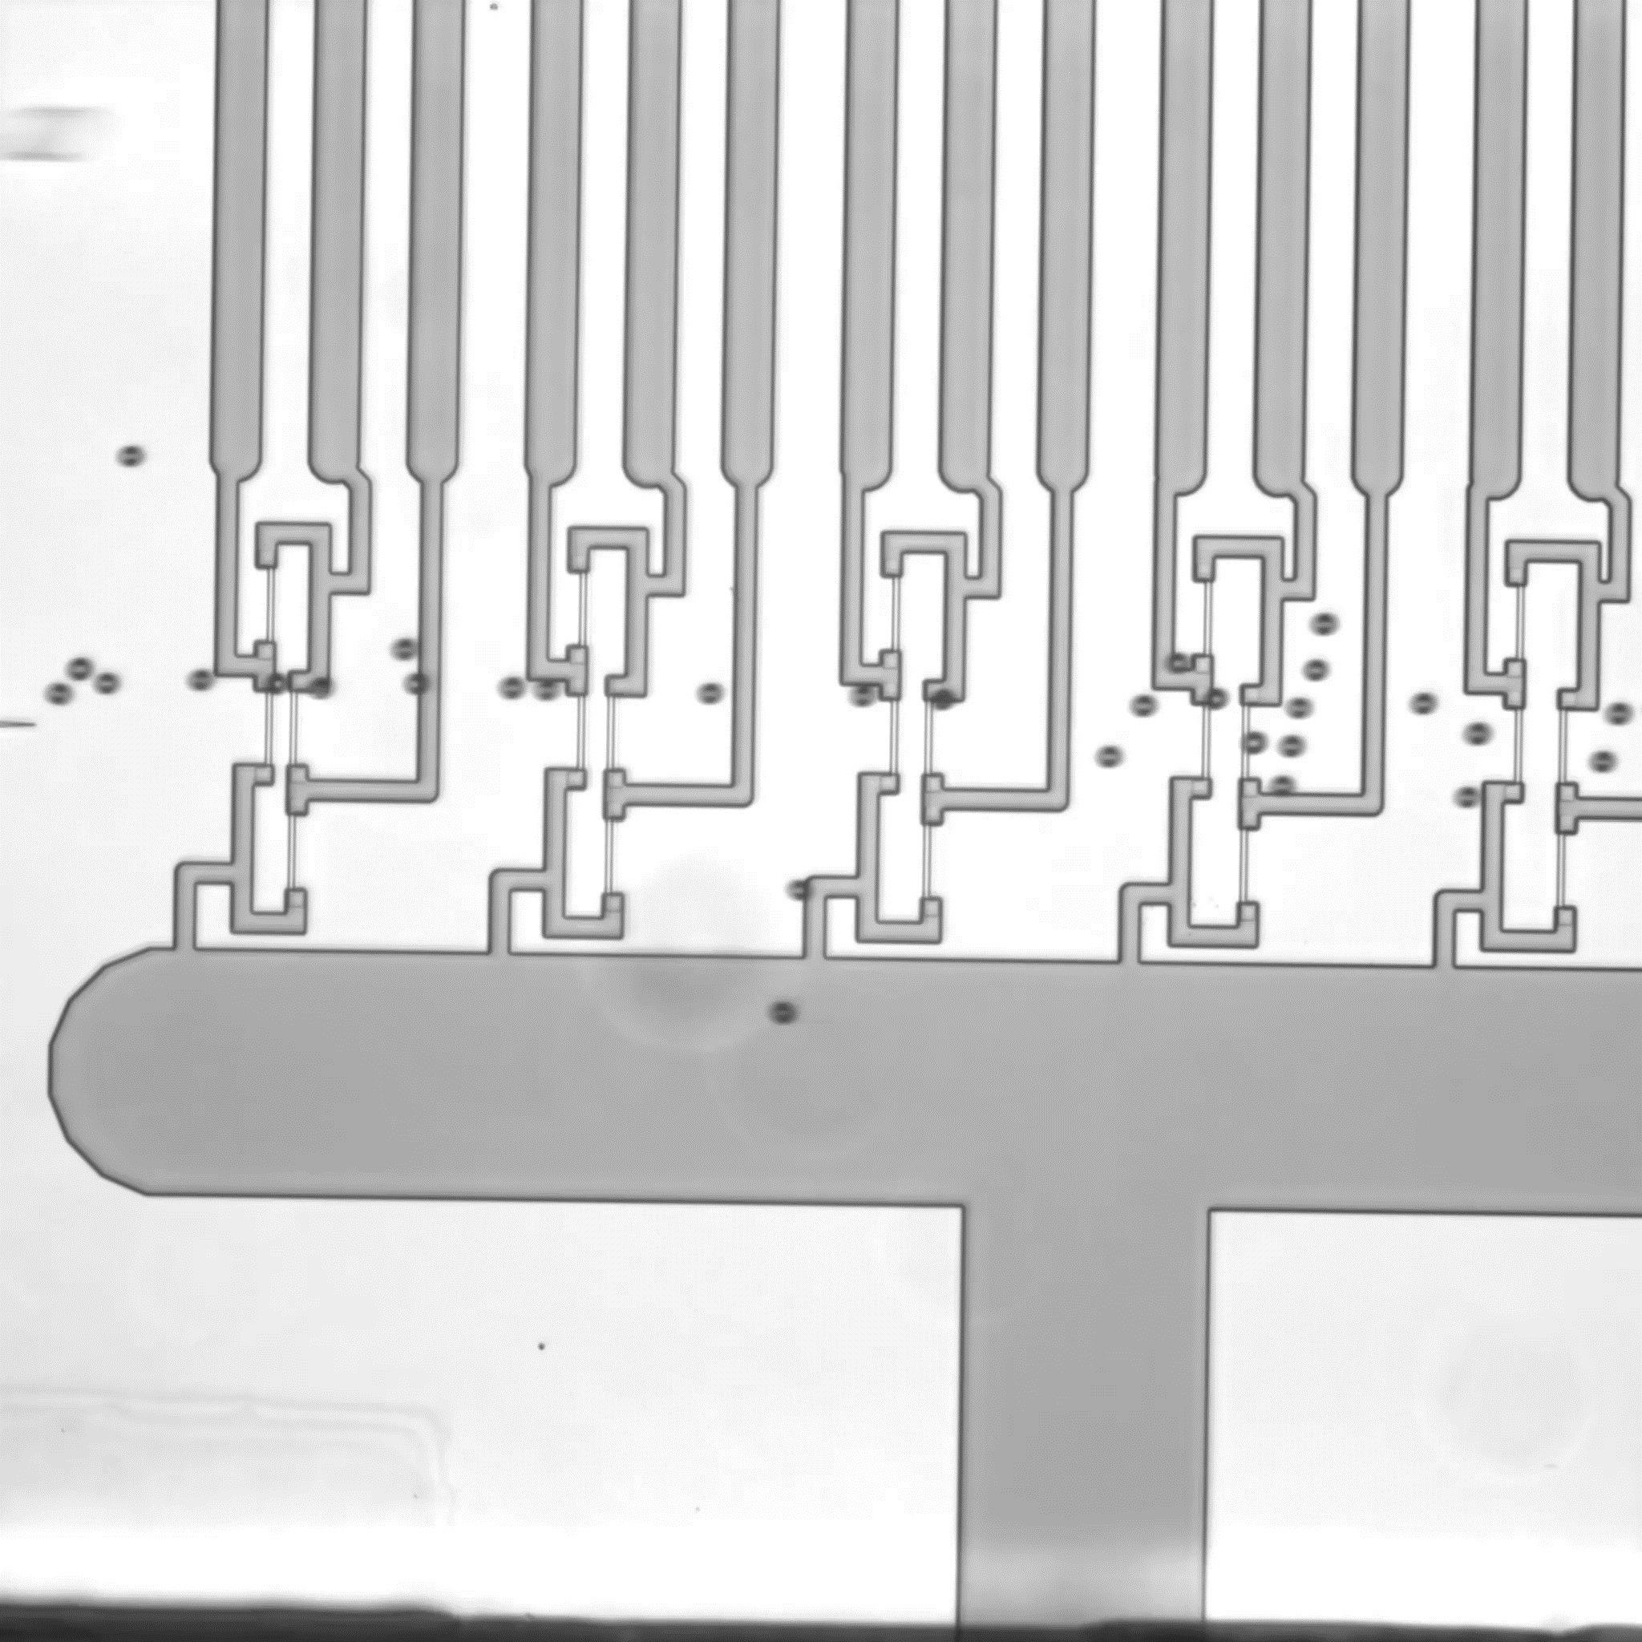
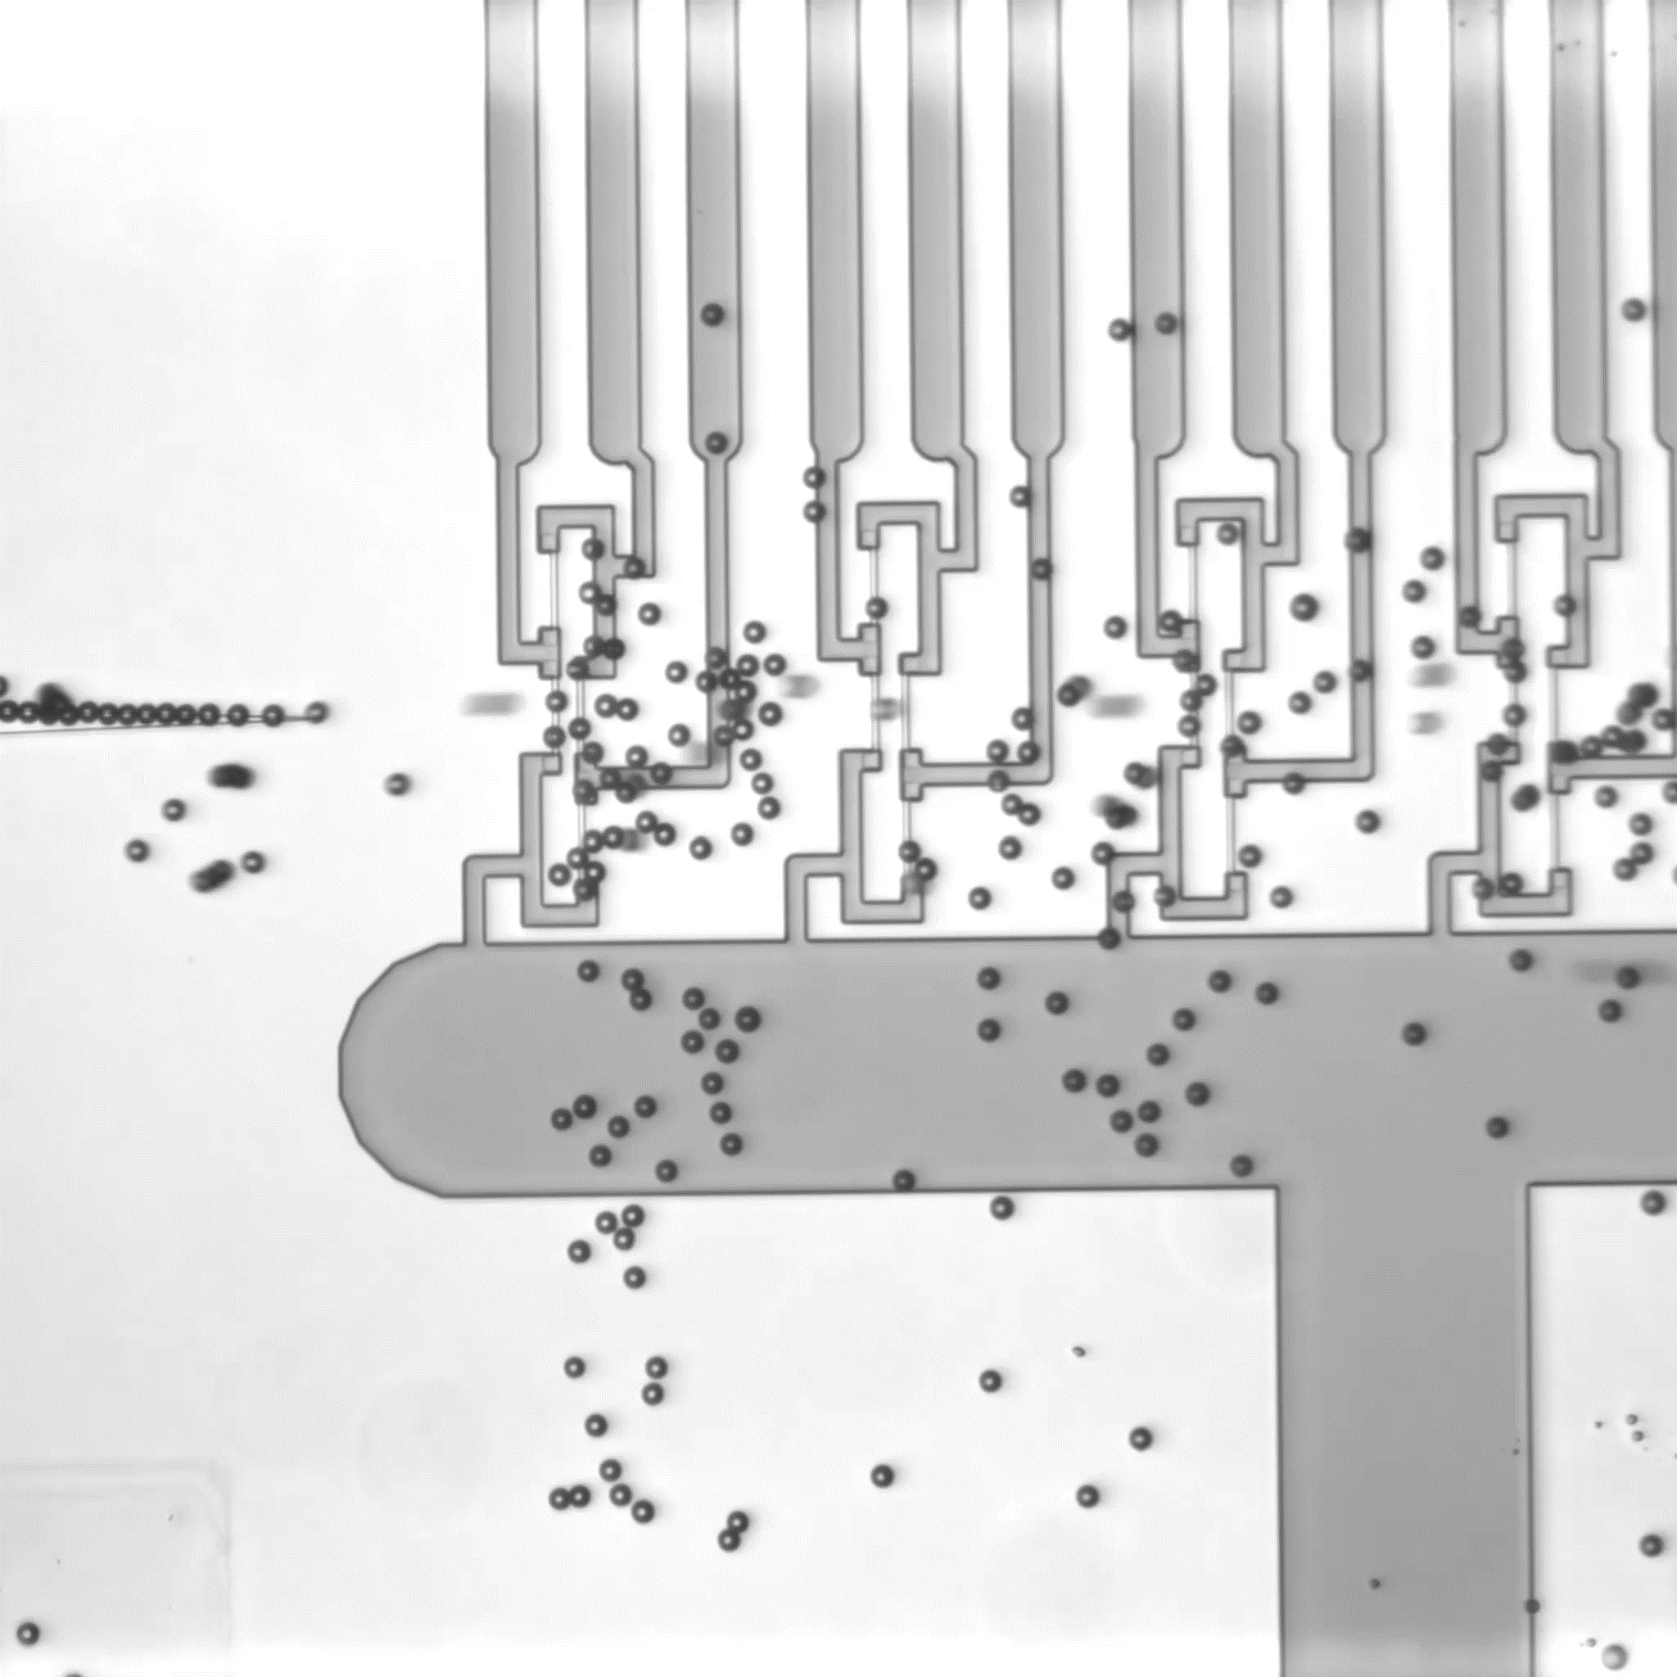
Plain Particles
Biotinylated Particles
Notes:
Sensor chip functionalized with neutravidin after the first sensor

Slide 32
Results
Experimental – Affinity-based Concentration Measurements in the Magnetic Flow Cytometer
Notes:
Affinity-base Concenctrations measured magnetically:
- Previously titrated surface coverage of beads now used in the affinity measurements
- Not only very large dynamic range, but also a coverage dependent behavior visible
- Properly functionalized sensor
→ Very robust and constant counting
→ adhesion of beads
→ Initial rise attributed to filling of magnetophoretic structures

Slide 33
Conclusion
Outcomes of this thesis
Established hydrodynamic and magnetic simulations for physical phenomena of rolling cells
Benchmarked absolute and differential concentration measurements for the magnetic flow cytometer
Developed a reference system for the variation of the surface receptor density
Demonstrated an affinity-dependent assay in the magnetic flow cytometer
Notes:
Physical phenomena of rolling cells with a bio-functionalized surface under laminar flow conditions were be simulated from a hydrodynamic and magnetic point of view
synergy of fluid dynamics, inertia, viscous, and body forces was illuminated in an analytical force equilibrium
numeric magnetic field simulation of MNP-laden spheres was correlated to dipole signals in the magnetic flow cytometer get further insights into signal patterns and possible parameter estimations
Absolute and differential concentration measurements were benchmarked for the magnetic flow cytometer
As a result, empirical correction factors, to account for losses in syringe, connectors, and the parabolic flow profile, were determined
To overcome these limitations → a relative counting apparatus has been engineered from two serially connected magnetic sensors.
However, the complexity and tentativeness of the differential system requires further developments beyond this thesis
A reference system for the variation of surface receptor density was established and subsequently evaluated
With the developed methods, several proteins were attached to the surface of microbeads covalently
Protocols optimized to preserve a reliable dose titration of biotin and antibodies for the coating density
Furthermore, the a magnetic measurement of weakly magnetized cells was evaluated in a pretest by MNP-coating the functionalized microbeads.
an affinity-based concentration assay was presented which reveals promising results for the magnetic measurement of biomarker concentrations or single cell surface proteins in the future
beads were immobilized in a laminar flow according to their respective biomolecular bond strength
Modified channels via physisorption and covalent attachment on various surfaces such as PDMS, Si3N4, and glass
right now physisorption is the favorized technique although it dismantles swiftly.
With these biologically augmented microfluidics, magnetic measurements showed a clear separation from fully- to sparsely-coated beads
Even, a dependency on the biotinylation-degree of microbeads has been measured with strong statistical support.

Slide 34
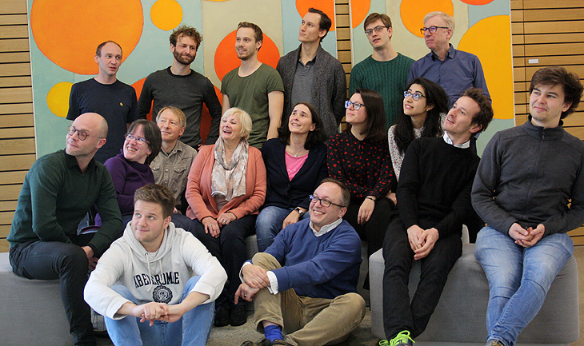
Thank you, LBE!

Slide 35
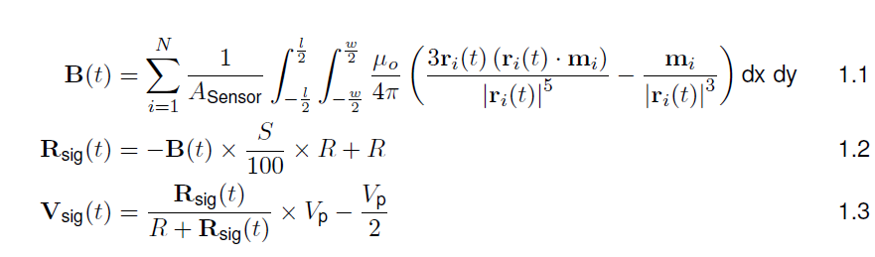
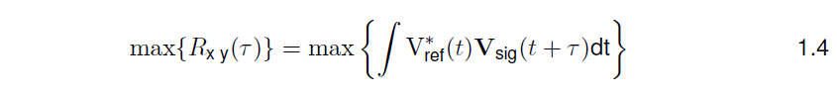
Magnetic Field Computations

Slide 36
Error Sources in the Magnetic Flow Cytometer

Slide 37
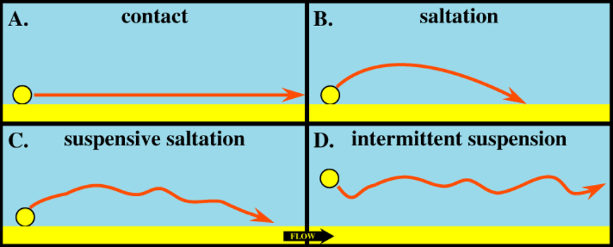
Affinity-dependent Bead Velocity
Magnetically measured bead velocity of biotinlyated bead is statistically higher
Probably attributed to a saltatory movement after adhesion to the channel (B,C)
After adhesion, a wake forms behind the bead thus causes increasing pressure on the back

Slide 38
Comparison of Empirically Determined Correction Factors

Slide 39
Error Sources Affinity-Dependent Concentration Measurement
Inital 100 µl:
magnetophoretic structures are filled
Steep rise
After 700µl:
Surface is saturated with biotinylated beads
Burst-Like Measurement of beads
After 800µl:
Empty Syringe and Sedimentation Effects play a role
➔ Less beads than expected are measured

Slide 40
Hysteresis Calibration of the Sensor

Slide 41
Ocean Nanotech MNPs

Slide 42
Micromod BNF-Dextran

Slide 43
Assessment of Physisorbed Biofunctionalization
Platereader Experiment with AlOx and SiN surfaces
Coverage with fluorescent streptavidin
Washing by 200 µl of buffer with a micropipette
No stability over multiple washing steps
SiN superior to AlOx

Slide 44
Anti-Biotin-PE Assessment

Slide 45
Fluorescent Evaluation of the Biofunctionalization

Slide 46
Surface Activation with Plasma
Difference to Piranha not measrurable in contact angle, but in functionalization operation

Slide 47
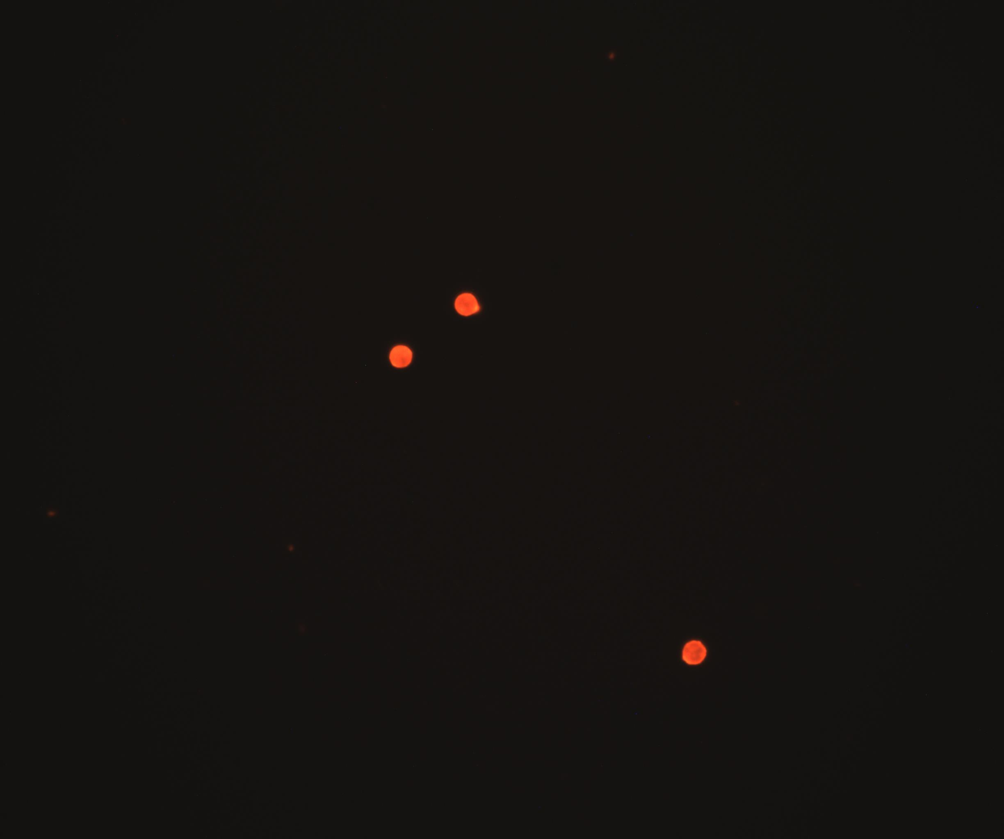
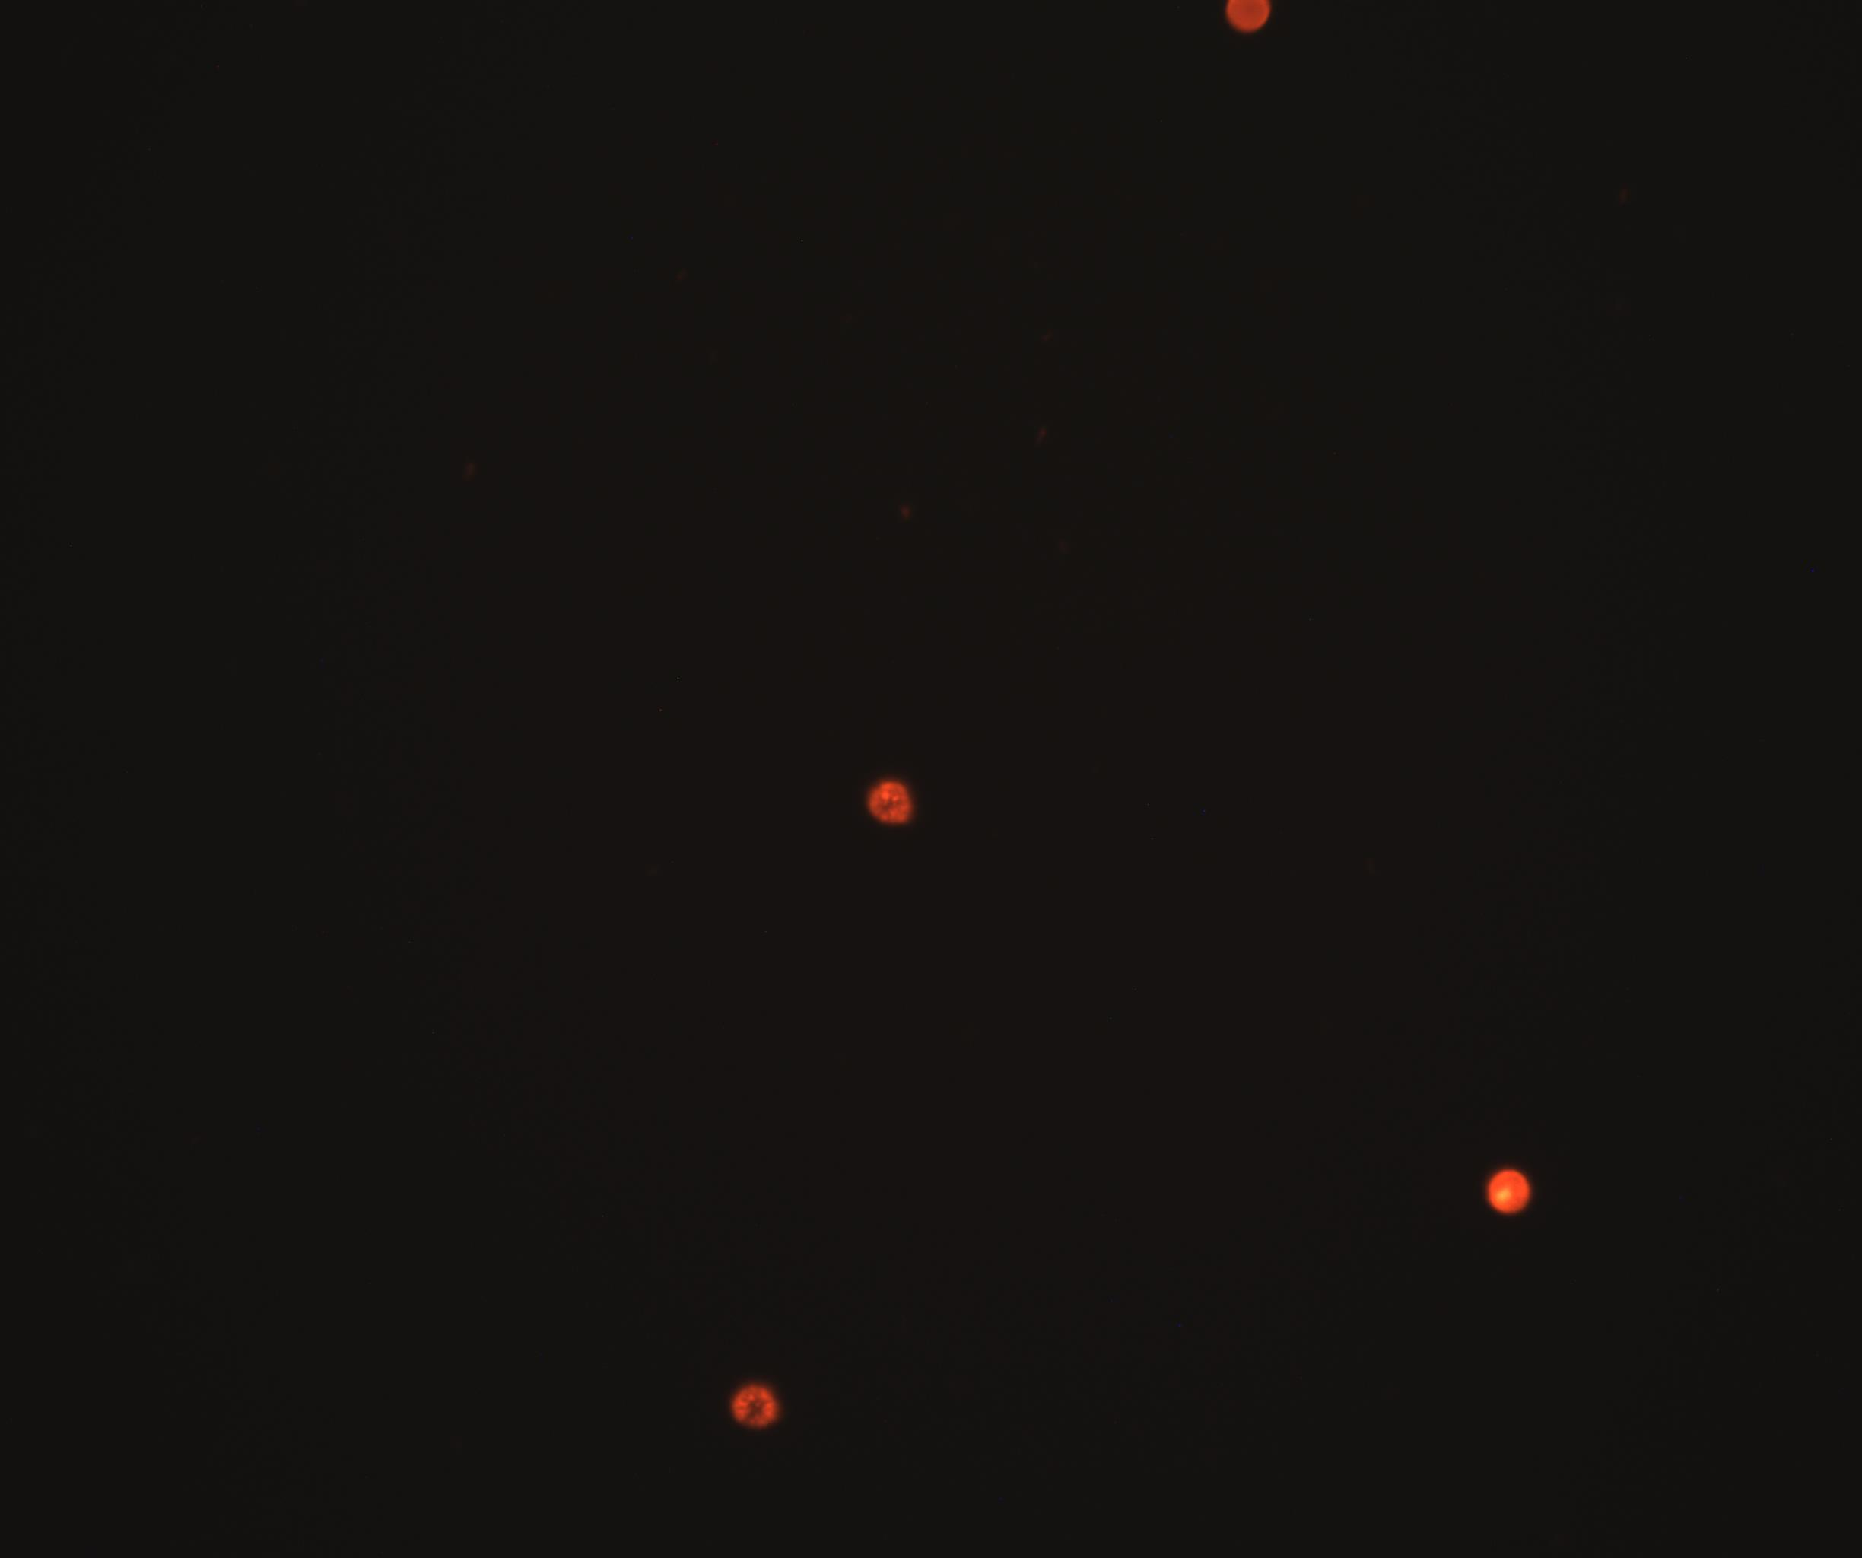
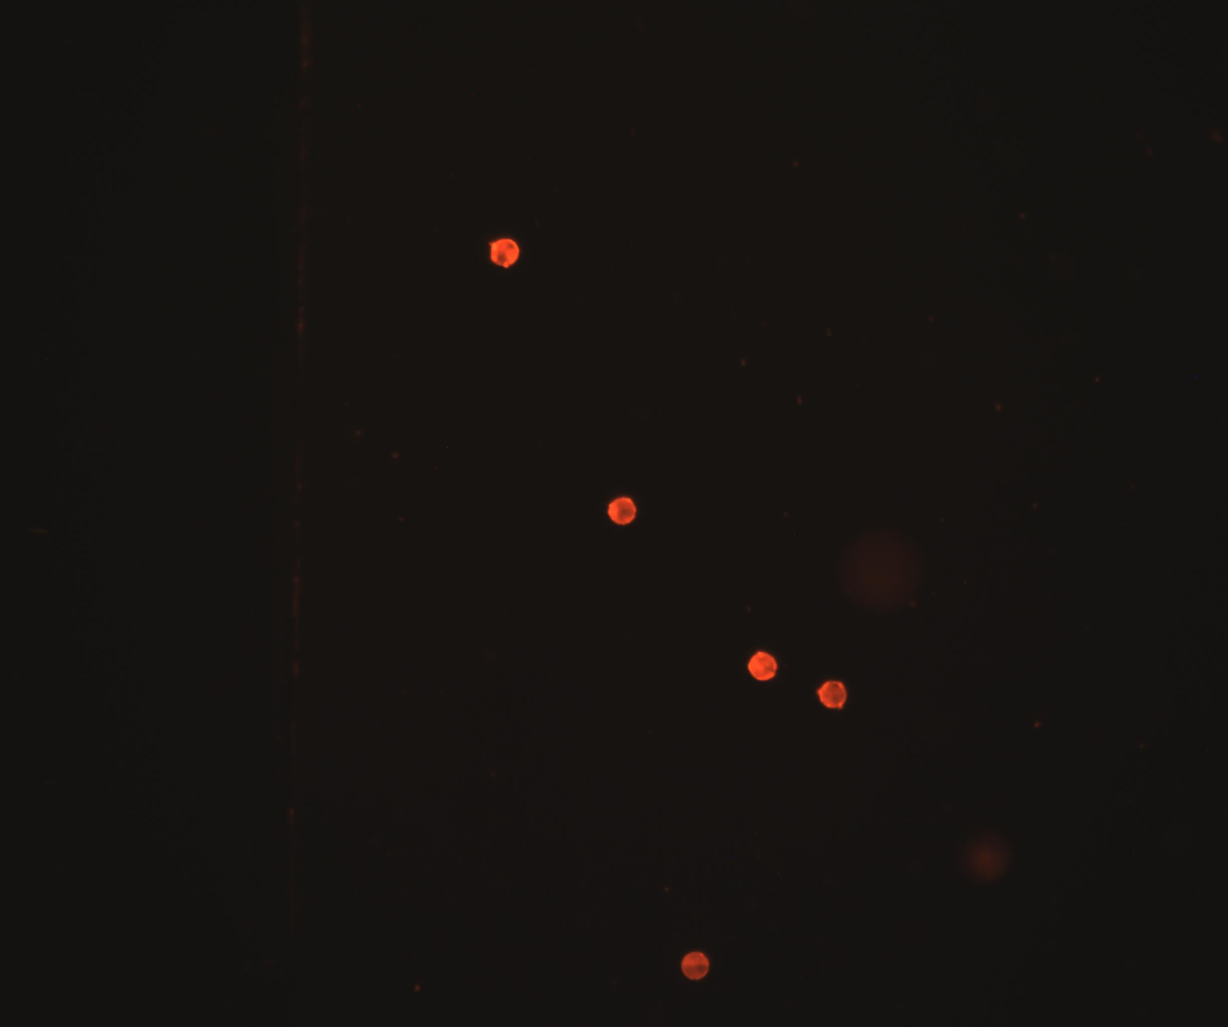
8µm Beads coated with streptavidin-redF-Dextran
Maximum Biotin Coverage
Approx 16% Coverage
Blank

Slide 48
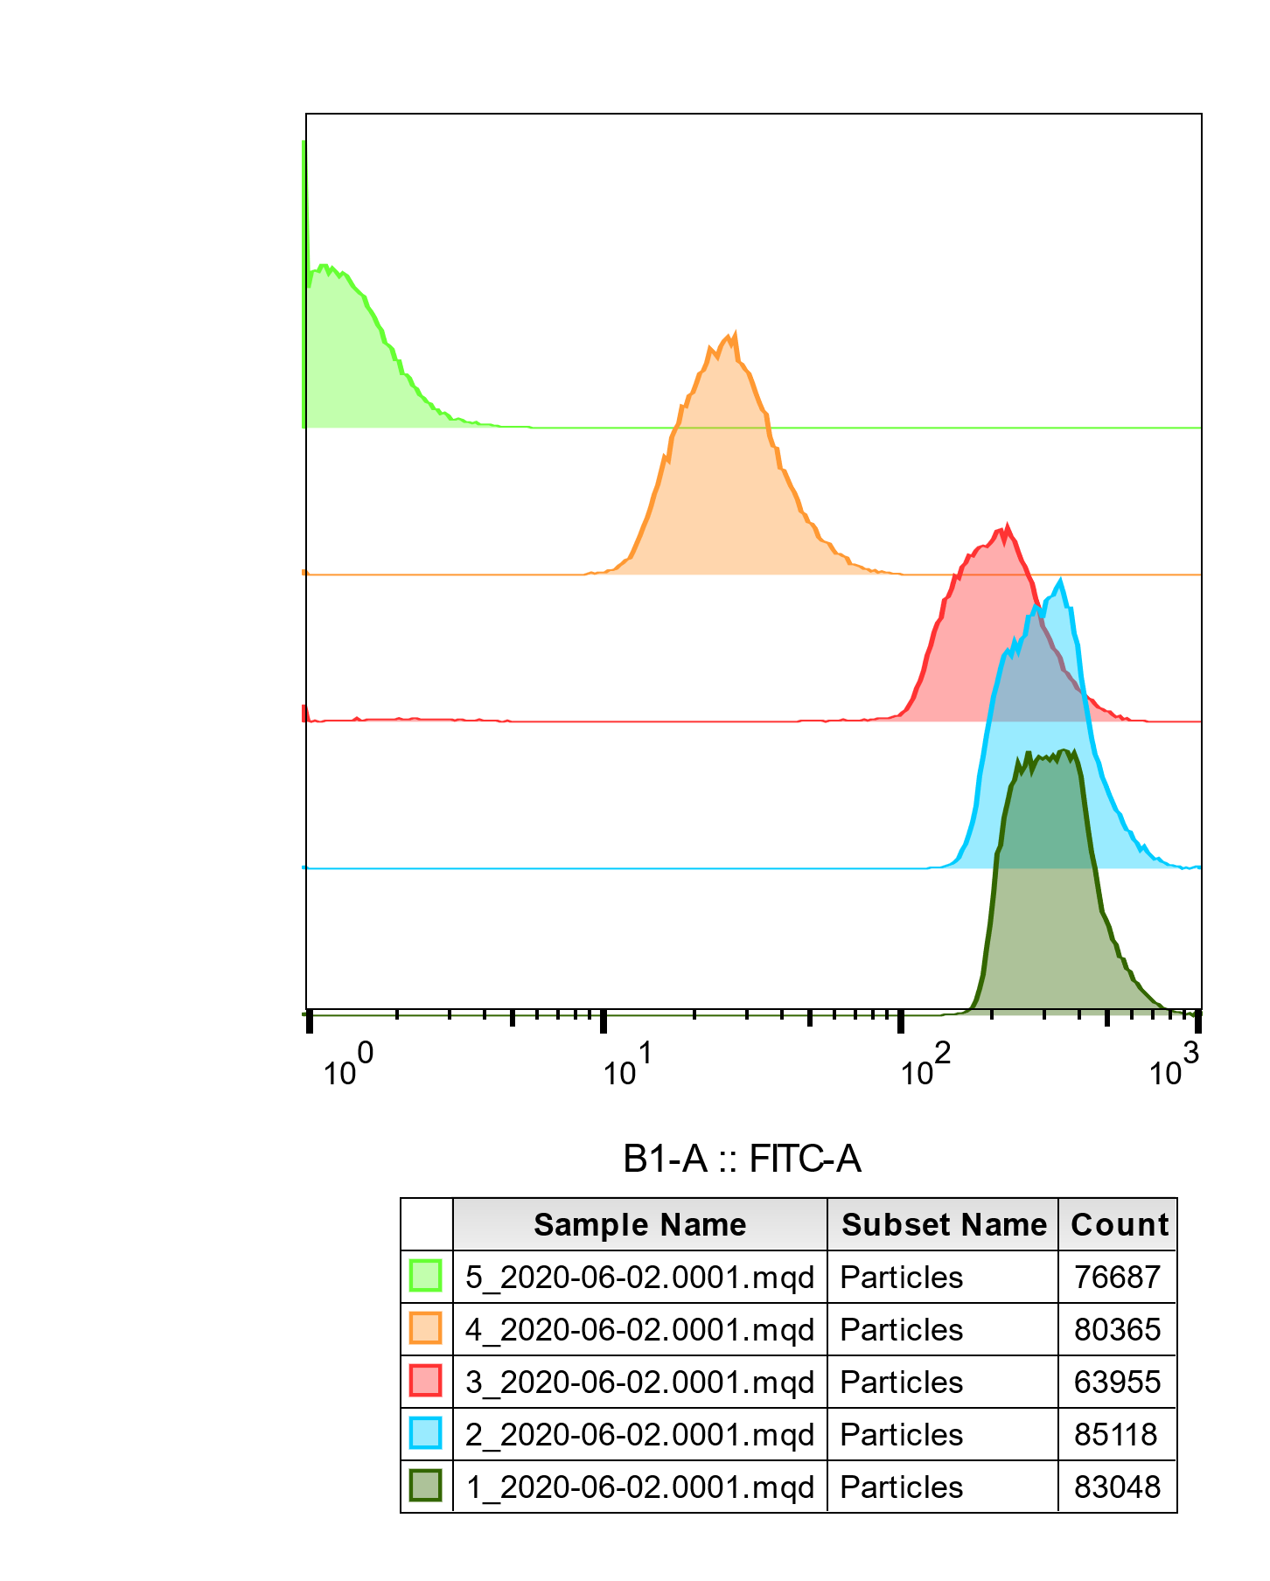

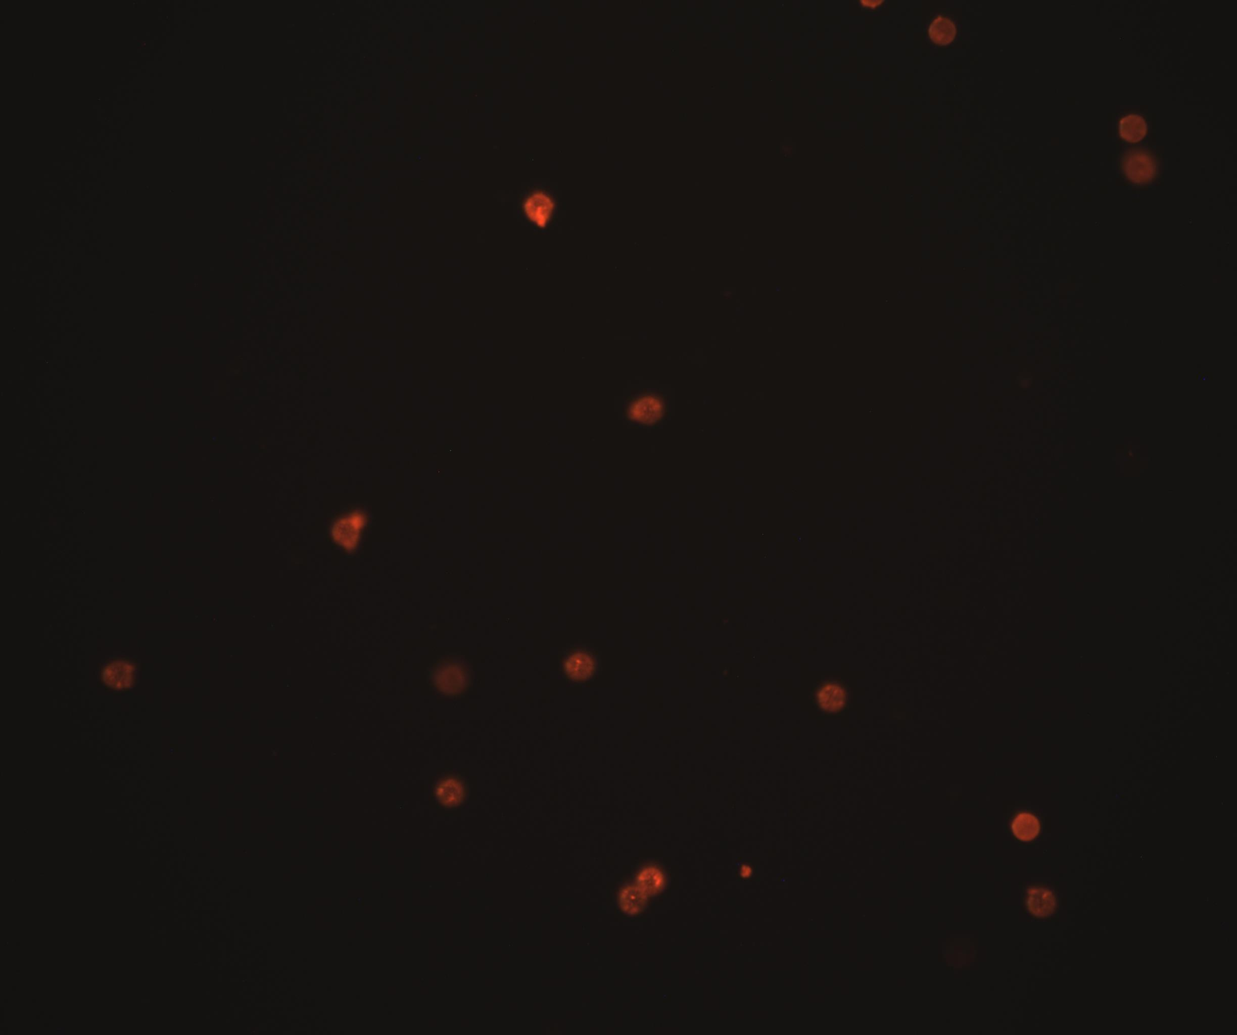


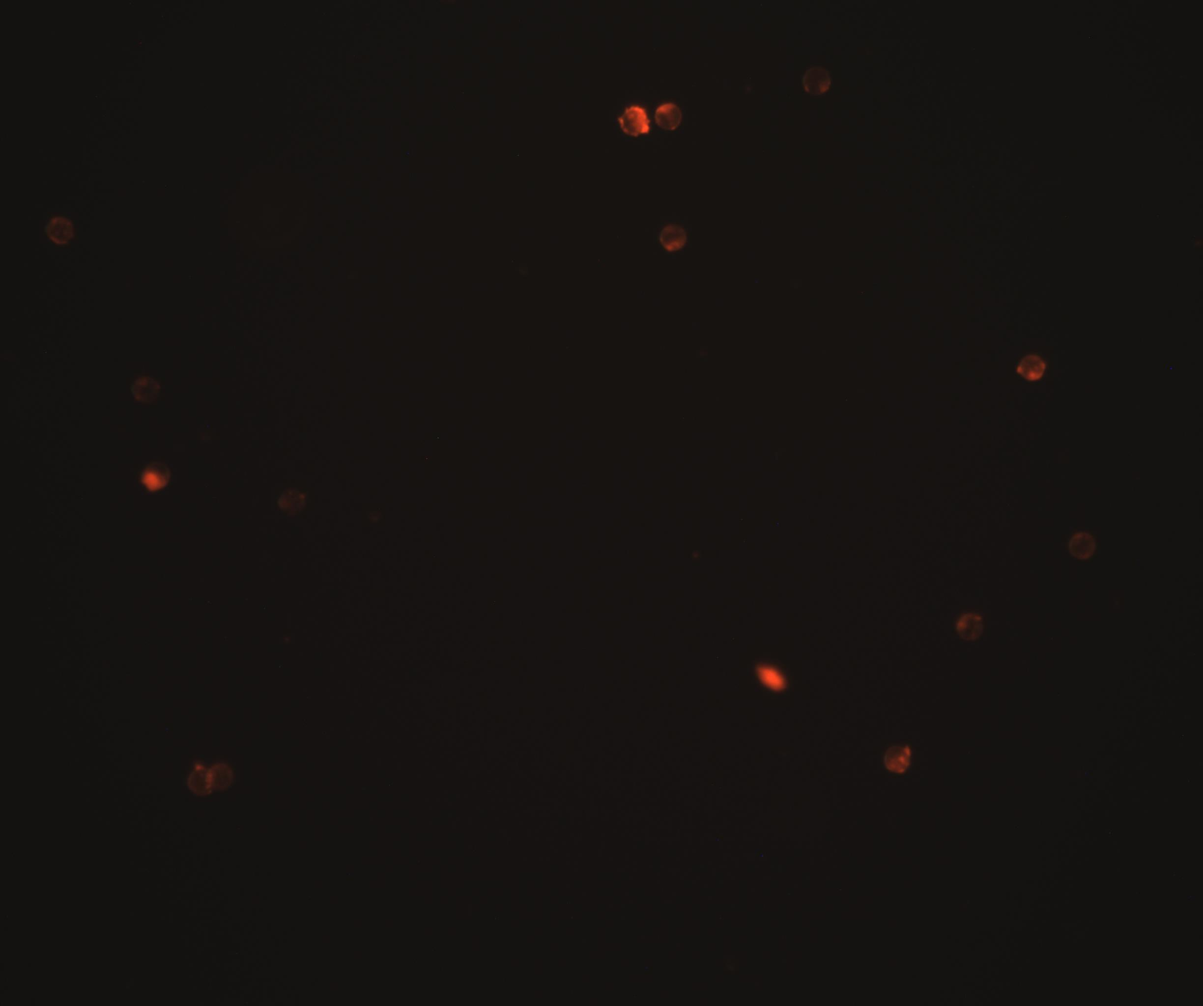

02.06. Biotinylation non-magnetic 8µm
Biotinylated, non-magnetic 8µm Polystyrol
Label: Streptavidin Atto-488
MES
TRIS
TAE
High
(1,dark green in FACS)
µ=52, $\sqrt{\text{σ}}$=11
µ=70, $\sqrt{\text{σ}}$=14
µ=42, $\sqrt{\text{σ}}$=19
Blank
(5,light green in FACS)
µ=40, $\sqrt{\text{σ}}$=9
µ=54, $\sqrt{\text{σ}}$=16
µ=24, $\sqrt{\text{σ}}$=0

Slide 49
Wafer - Spincoating
17.07 3“ SU8-3050 @ 3000 rpm written same day
23.07 3“ SU8-3050 @ 3000 rpm written after one week
27.07 3“ SU8-3050 @ 3000 rpm written same day
29.07 3“ SU8-3025 @ 3000 rpm written two days after
4“ desired 150µm Layer
~ 98 µm
~ 94 µm
~ 53 µm
~ 44 µm
~ 115µm
Water Desorption 120min@160°C
Cool to RT
3ml SU8 (1ml/inch Wafer diameter)
Softbake 1min@65°C 15min@95°C(50µm) 10min@95°C(25µm)
Laser writing / Flood exposure
Spincoat 5s@500rpm(100rpm/s) 30s@3000rpm(300rpm/s)
Clean with Aceton 30s@7000rpm
Post-Exposure-Bake 1min@65°C 5°C@95°C
Develop mrDev 600 6-10min with shaking Optionally: in sonication Bath
Cool to RT

Slide 50
Wafer – Laserwriting
Parameter | Value
Spot size | 0.01 mm
Overlap | 80%
Modulation | 100%
Z-Position | -6.782
velocity | 40 mm/s (omitted lines in dialog)

